Slide 1

PhD Report: Blockchain for data certification
Decentralized Issuer Authentication
and Scalable Traceability
Giacomo Zonneveld
Supervisor: Prof. Marco Baldi
Department of Information Engineering — Università Politecnica delle Marche
g.zonneveld@univpm.it

Slide 2

Introduction: Two contributions
Distributed Ledger Technology offers strong notarization guarantees — immutability, decentralization, transparency — but two open problems remain when going fully decentralized:
Contribution 1
Contribution 2
Decentralized issuer authentication
Scalable certification of continuous data
Without a central authority, how do we guarantee the real-world identity of the credential issuer?
How do we certify a continuous flow of data on a public blockchain without the transaction costs exploding?
→ Security analysis of Block.co (BlockDLT 2026 - COMPSAC 2026)
→ Multi-Level Indexed Merkle Trees (ICBC 2025¹)
¹G. Zonneveld, G. Rafaiani, M. Battaglioni and M. Baldi, "Data Certification Strategies for Blockchain-based Traceability Systems," 2025 IEEE International Conference on Blockchain and Cryptocurrency (ICBC), Pisa, Italy, 2025, pp. 1-8, doi: 10.1109/ICBC64466.2025.11114484.
2

Slide 3
Digital credential certification: state of the art
Approach | How it works | Limitation
Centralized PKI | Institution signs with private key; CA-issued certificate verifies it | Single point of failure; if institution or CA disappears, signatures become unverifiable
Blockchain + digital signature | Credential hash anchored on chain, signed by issuer | Still needs authenticated distribution of public keys
Permissioned / DIDs / EBSI | Consortium of accredited issuers; trust anchors for identity | Reintroduces some form of central authority
The fully-decentralized case without a central authority at all remains exposed
3

Slide 4
Block.co: a real fully-decentralized protocol
Issuance flow:
Two verification modes:
true
block_co
metadata
false
The problem with external mode:
The trust anchor is the blockchain itself plus a web domain: it is circular
Any user can publish an address on their own URL and claim to be the legitimate issuer
4

Slide 5
Forgery attack: threat model and procedure
Threat model
Attacker capabilities:
Access to a Bitcoin wallet (mining fees only)
Public HTTPS URL under their control
Knows how to use standard cryptographic primitives
Ability to edit PDF metadata
Out of scope:
Breaking cryptographic primitives
Compromising Block.co infrastructure
Stealing private keys of real issuers
Attacks on the Bitcoin network itself
No cryptographic primitive is broken
Attack procedure (4 steps)
Craft fake PDF; insert attacker's Bitcoin address + attacker's domain; set block_co = false
1
Hash PDF; build single-leaf Merkle tree; extract root and proof
2
Submit Bitcoin transaction with the root in OP_RETURN, paying only mining fees
3
Populate Chainpoint Proof in PDF (targetHash, merkleRoot, proof, tx id)
4
Verifier returns: "Document is valid!"
5

Slide 6
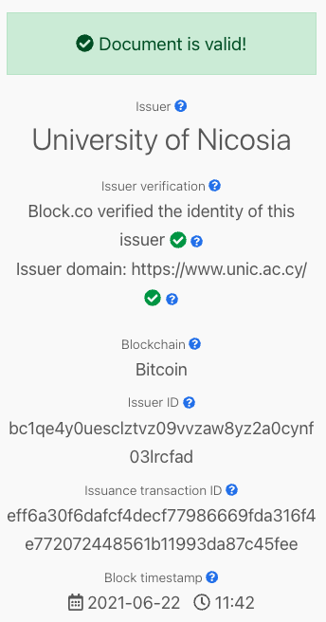
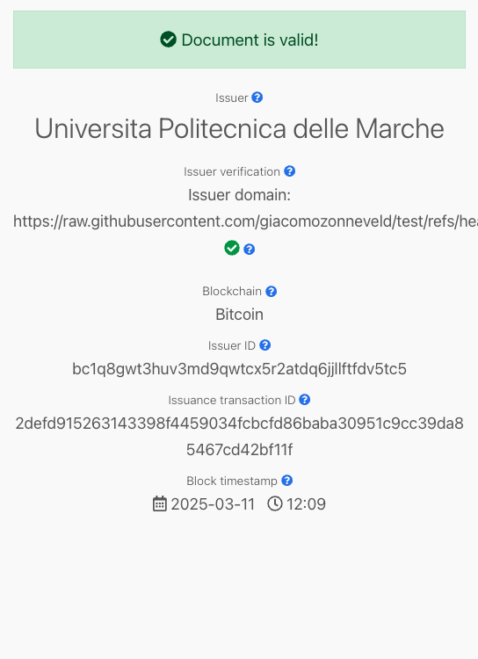
Authentic vs forged certificate verification
Authentic certificate
Forged certificate
6

Slide 7
Why the single-checkmark matters
The forged certificate bypasses the internal check.
Internal verification
Centralized whitelist maintained by Block.co
Blockchain as an additional layer of verification
Could be replaced by a traditional PKI
External verification
Bitcoin address ↔ URL
The only check that genuinely leverages decentralization
And it is precisely the broken one
If decentralization is replaced by a centralized whitelist,
you might as well drop the blockchain and use a PKI
7

Slide 8
Positioning vs the Blockcerts attack (Baldi 2020²)
Same theoretical principle, substantially different attack vector
 | Blockcerts (Baldi 2020) | Block.co (this work)
Credential format | JSON (Open Badges) | PDF + metadata
Cryptography | Digital signatures | Merkle anchoring only
Architecture | Fully decentralized | Hybrid (centr. + decentr.)
Flag bypass needed | No | Yes (block_co = false)
Attack artifacts | Fake JSON + key pair | Fake URL + Bitcoin wallet
Underlying principle generalizes (missing real-identity binding)
The attack vector is new
²M. Baldi, F. Chiaraluce, M. Kodra, and L. Spalazzi, “Security analysis of a blockchain-based protocol for the certification of academic credentials,” CEUR Workshop Proceedings, vol. 2580, 2020.
8

Slide 9
Responsible disclosure and countermeasures
Responsible disclosure
Possible countermeasures
Permissioned blockchain
Only consortium members verified by a trusted authority can write certification transactions. Anyone can verify
DIDs + ZKPs
Decentralized Identifiers with Zero-Knowledge Proofs anchored to recognized authorities (e.g., EBSI model)
Hybrid public registry
Publicly accessible list of verified issuer addresses, with clear warnings on unverified issuers
6 May 2025
Ticket BC-1344 filed:
"Vulnerability of Block.co to certificate forgery"
May 2025 – May 2026
No response, no acknowledgment, no remediation timeline received
20 May 2026
Re-tested the original forged certificate against the public verifier
Vulnerability still exploitable
Fully decentralized identity verification is structurally infeasible
9

Slide 10
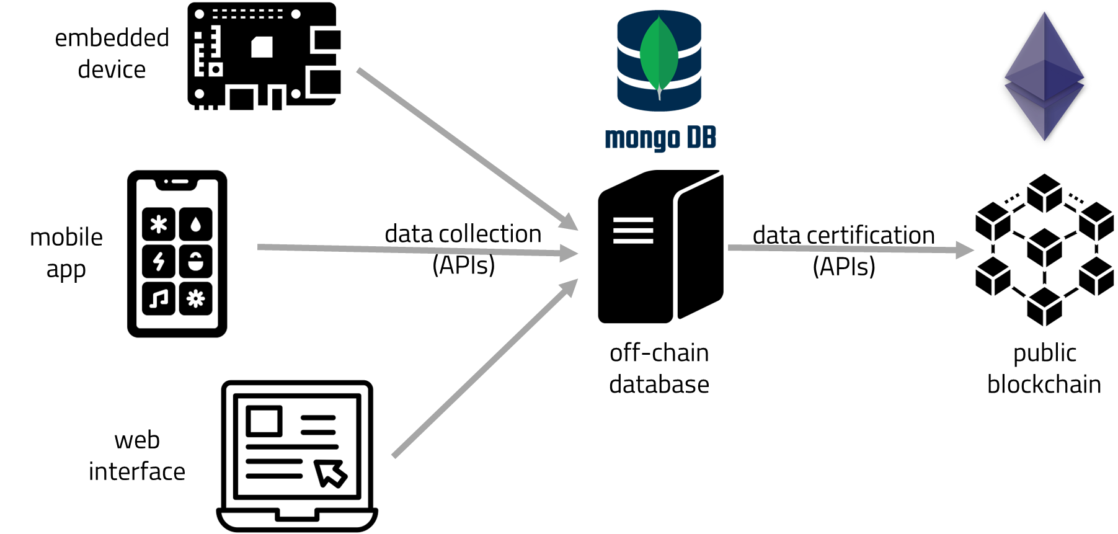

Scalable certification: system model
Off-chain data
collection and processing
Design data certification strategies that minimize transaction costs while preserving public-blockchain decentralization.
Single Data Certification
Multiple Data Certification (Merkle)
N data → N transactions
N data → 1 transaction
$$C_{tot}= {N∙C}_{hash}+N∙p+C_{hash}$$
$$C_{tot}= {(2N−1)∙C}_{hash}+(2N−1)∙d+p+{\log_{2}{N}∙C}_{hash}$$
Dominated by N·p (transaction fees)
Transaction cost collapses to a single p
where | N: data entries, d: node size, p: cost of a transaction
10

Slide 11

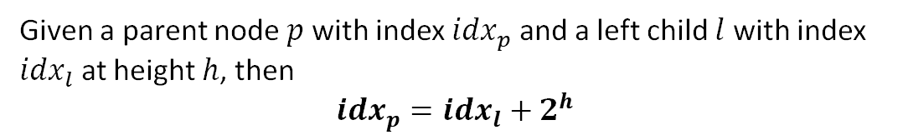

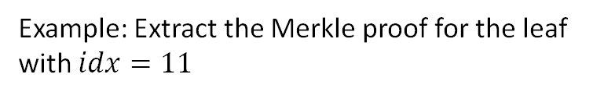
Indexed Merkle Tree
Given a parent node $p$ with index ${idx}_{p}$ and a left child $l$ with index ${idx}_{l}$ at height $h$, then
$${idx}_{p}={idx}_{l}+2^{h}$$
Example: Extract the Merkle proof for the leaf with $idx=11$
$$\text{Build} \text{time} \text{complexity}\text{:} O(N)$$
$$\text{Merkle} \text{proof} \text{extraction} \text{time} \text{complexity}\text{:}$$
$$O(h)=O(\log_{2}{N})$$
N not a power of 2: the last node at odd-length levels is duplicated, keeping the indexing rule consistent
11

Slide 12


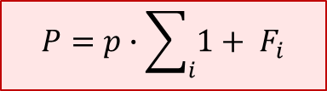
Multi-Level Indexed Merkle Tree
Operational issue: transactions fail due to fluctuating gas prices → naive approach rebuilds the entire tree
Our approach
New data arriving between a failed tx and the retry is appended as a new sub-tree at Level 0 — without reshuffling already-assigned indices.
Cost paid by the manager
$$P=p∙\sum_{i}{1+ F_{i}}$$
without our scheme (grows with failures $F_{i}$)
↓
Use case: Proof of Attendance (CTE SQUARE)
$$P=p$$
with our scheme (independent of failures)
12

Slide 13
Performance evaluation
Comparison vs merkletreejs and merkle-tools — 250k iterations, 5% trimmed mean (Apple M1 Pro)
Tree generation
Merkle proof extraction
At N = 1000:
Tree generation: +24% vs merkletreejs, +48% vs merkle-tools
Proof extraction:
+185% vs merkletreejs, +233% vs merkle-tools (2–3× faster)
13

Slide 14

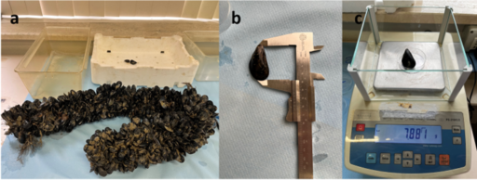
Deployed in three real use cases
Same data-agnostic core, three completely different domains
Event Ledger
FOLOU
BperTrack
CTE SQUARE Pesaro
EU Horizon Europe
fabGRADE
Proof of Attendance platform: generation, issuance and verification of certificates anchored to the Ethereum blockchain
Measuring and estimating food waste across agriculture and fishing. Certifying mussel-farming process data
Blockchain-based certification architecture for transparency, traceability and quality assurance in manufacturing
CUP D74J22000930008
GA: 101084106
Industrial partnership
From cultural events to mussel farms: one architecture, many domains.
14

Slide 15
Conclusions and future work
Done
Forgery attack on Block.co
Structural limit of fully decentralized authentication, demonstrated end-to-end (BlockDLT 2026 - COMPSAC 2026)
Multi-Level Indexed Merkle Tree
Fault-tolerant architecture, 2–3× faster proof extraction than reference libraries (ICBC 2025)
Three real-world deployments
Event Ledger, FOLOU, BperTrack data-agnostic core in production
Future work
Extend the security analysis
Audit other decentralized protocols for similar structural flaws.
Integrate Layer 2 blockchain for data certification
Collect and analyze usage data on use cases
Thank you for your attention
15

Slide 16
Thank you for the attention
Giacomo Zonneveld
Supervisor: Prof. Marco Baldi
Department of Information Engineering — Università Politecnica delle Marche
g.zonneveld@univpm.it

