Slide 1


BperTrack: A Blockchain-Based Certification Architecture for Transparency, Traceability, and Quality Assurance in Manufacturing
Giacomo Zonneveld¹, Giulia Rafaiani¹, Flavio Tonetto², Gianalberto Cecchini², Davide Maffoli³, Luca Pagnoni³, Marco Baldi¹, Franco Chiaraluce¹
¹ Università Politecnica delle Marche, Ancona, Italy
² Sinergia Consulenze S.r.l., Pesaro, Italy
³ FAB S.r.l., Gallo di Petriano (PU), Italy

Slide 2
MOTIVATION
The public-versus-private tension
Public chains
Ethereum, Bitcoin — the maximalist option
Strong guarantees: immutability, transparency, trustless verification
Anyone can verify, with no trust in any party
But: one transaction per record does not scale economically for SMEs
Private / permissioned
Hyperledger, private Ethereum, consortium chains
Cheap transactions, controllable performance
But: re-introduces a central authority, asymmetric trust
Privileged actors can roll back, censor, or alter records
Can we have public-chain trust guarantees at SME-manufacturing cost — and as open-source?
2 / 12

Slide 3
OUR CONTRIBUTION
What BperTrack contributes
01
Open-source Cert Engine
GPL-3.0 github.com/secomms/certengine
Deployable microservice, not a research prototype. Docker, Node.js, REST API, statistics endpoints, Prometheus metrics.
02
Public-chain anchoring
Transparency
Records anchored to Ethereum. Verification requires no trust in our infrastructure; anyone can verify independently.
03
Merkle-tree batching
Traceability
One transaction certifies an entire batch. Decouples cost from record count, enabling a tunable cost/timeliness trade-off.
04
Data-agnostic certification
Quality assurance
Any JSON document, including Base64-encoded PDFs and images. No schema lock-in. Quality artifacts fit the same pipeline.
05
Validated against real production data
FAB Manufacturing
End-to-end integration with a production database, validating the architecture against real data.
The three pillars of the title map to three design choices: public chain → transparency · batching → traceability · data-agnostic → quality assurance.
3 / 12

Slide 4
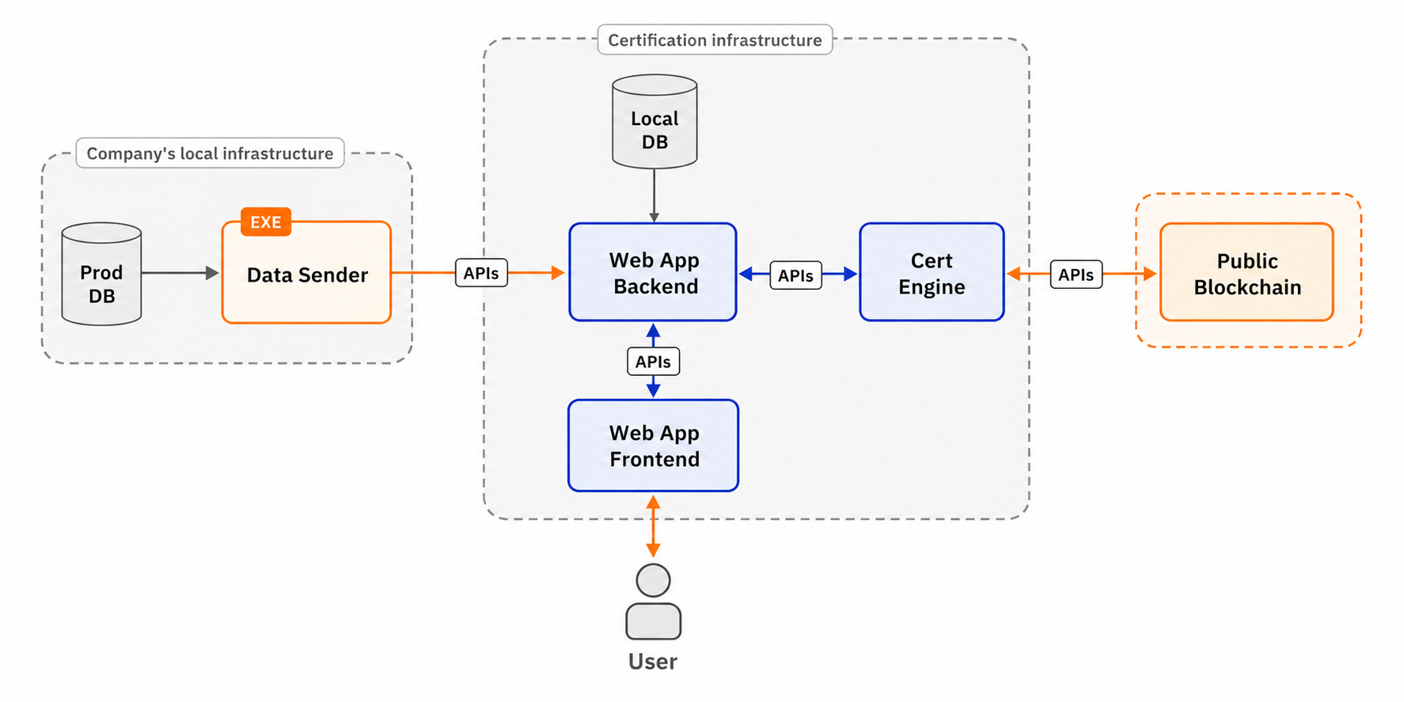
SYSTEM OVERVIEW
Hybrid on-chain / off-chain architecture
Data Sender
Extracts traceability records from the production process.
Cert Engine
Dockerized Node.js microservice.
Hashes, batches, anchors, returns proofs.
It uses optimized Indexed Merkle Trees¹.
In-memory only: data deleted after certification procedure is completed.
Web App Backend
Persists records + certification metadata. Convenience layer, not required for verification.
Web App Frontend
End-user interface: scan a product label, retrieve full history, verify.
¹ G. Zonneveld, G. Rafaiani, M. Battaglioni, M. Baldi, "Data Certification Strategies for Blockchain-based Traceability Systems," 2025 IEEE International Conference on Blockchain and Cryptocurrency (ICBC), Pisa, Italy, 2025, pp. 1-8, doi: 10.1109/ICBC64466.2025.11114484.
4 / 12

Slide 5
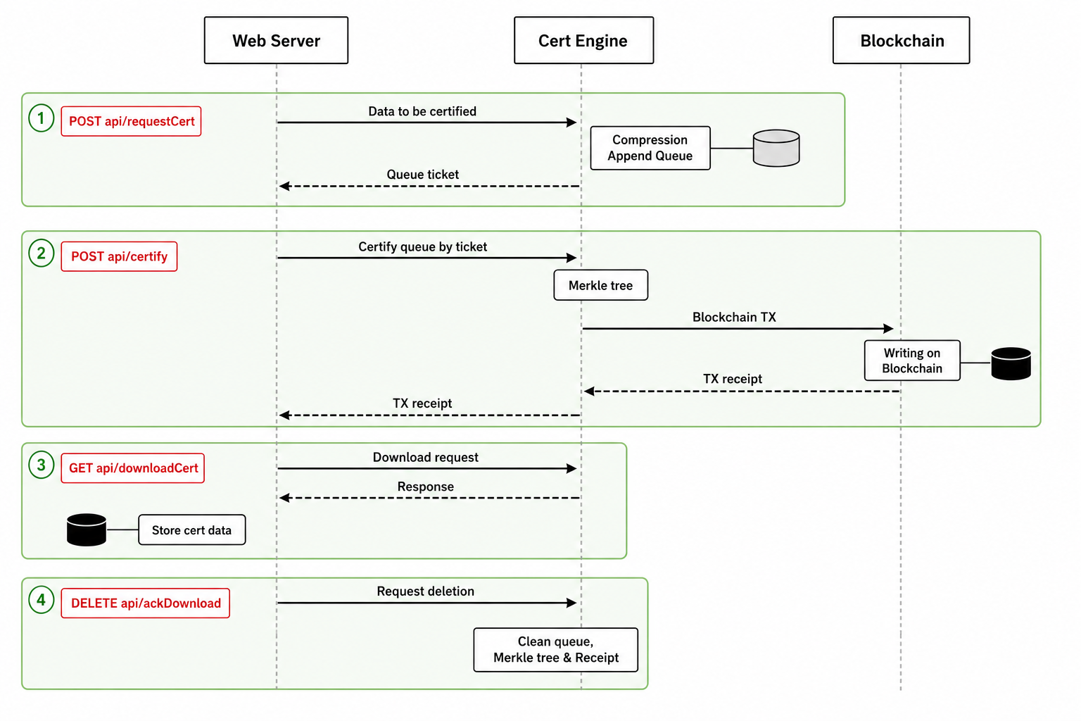
WORKFLOW
Certification in four steps
1
Forwarding, formatting & hashing
JSON with ID + certData array.
/requestCert → SHA-256 of each record enqueued. Returns a ticket. No plaintext stored
[ PLACEHOLDER ]
2
Certification trigger
/certify → Merkle tree built over the queue, root submitted in a single transaction. Returns tx hash + timestamp
Insert Figure 2 from the paper:
Certification workflow (sequence diagram with the Cert Engine APIs)
3
Proof download
/downloadCert → Merkle proofs returned, one per record.
Receipt = proof + tx hash
4
Data wipe out
/ackDownload wipes the queue
Steps 2 and 3 are decoupled: operators commit when batch size or queue age makes gas worthwhile — this is the cost/timeliness knob.
5 / 12

Slide 6
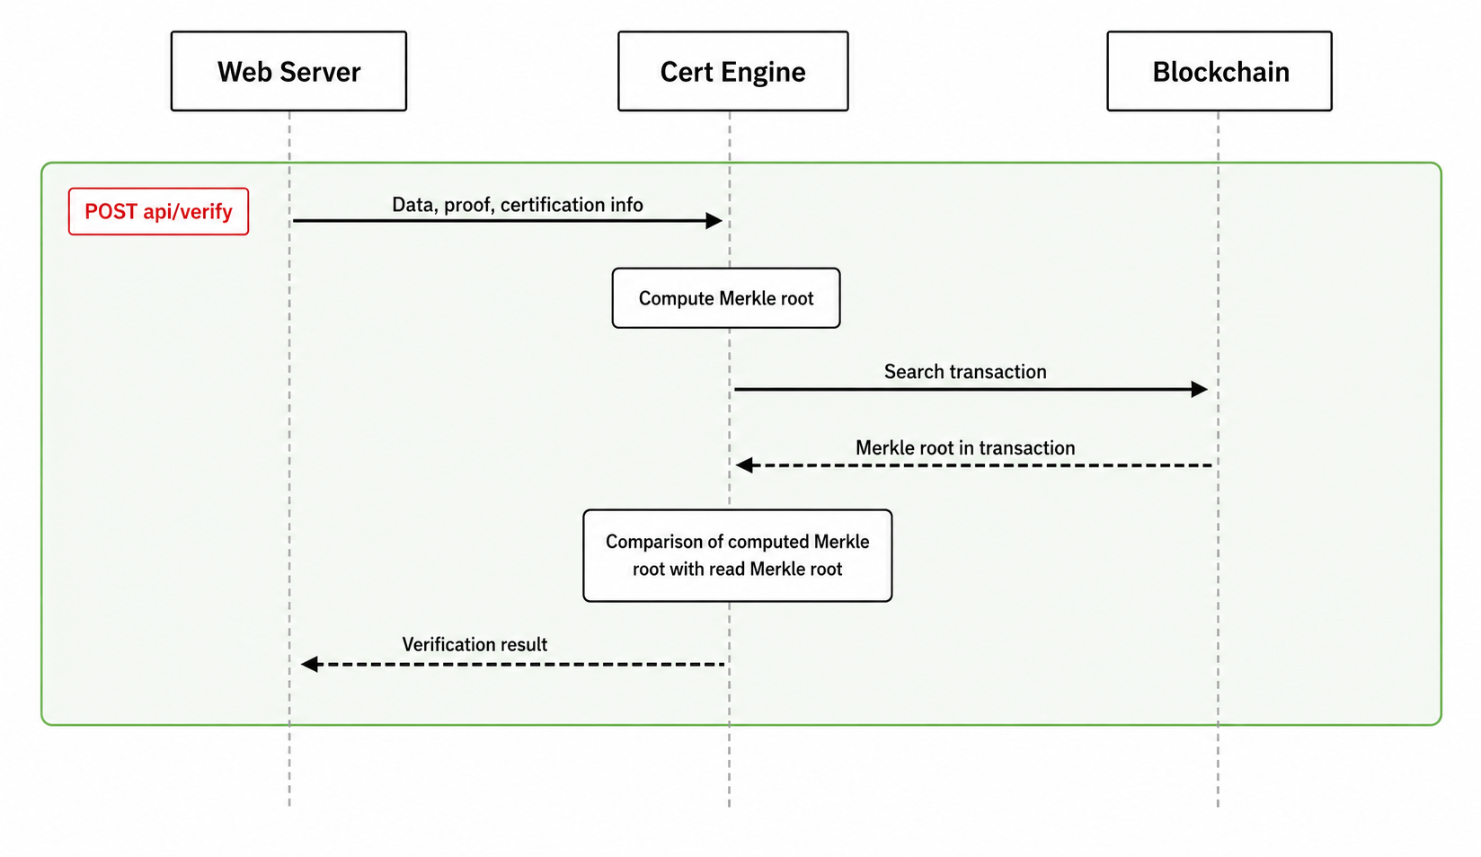
WORKFLOW
Verification: stateless, infrastructure-independent
Properties
Stateless: no server state needed
No trust in BperTrack infrastructure required
Anyone with the data can verify, even years later
6 / 12

Slide 7
ECONOMICS
Why Merkle batching makes the public chain viable
Naive: one tx per record
On-chain cost: N × (one Ethereum tx)
Scales linearly with record count
Non-viable at thousands of records / day
BperTrack: one tx per batch
On-chain cost: 1 Ethereum tx per batch (32-byte root)
Independent of batch size
Per-record verification stays O(log₂ n)
Batch size and timing become a knob, not a constraint
Built-in fee control
/api/getGasPrice returns live base fee, priority fee, max fee (EIP-1559) and converted EUR estimates. Operators can schedule commits against favorable network conditions.
7 / 12

Slide 8
REFERENCE INTEGRATION
FAB Manufacturing — driving requirements
Setup
Italian SME manufacturer, discrete production
Production organized in Pools (orders grouped by work center)
Product label encodes year, week, last digits of Pool ID
Data Sender connected directly to their production database
Certified fields
Field | Meaning
Pool | Batch identifier (work center group)
ProdID / ItemID | Production order / article
Date | Timestamp of record insertion
ConformingPieces | Quality: pieces produced to spec
WorkCenter | Where the order was executed
RawMaterial | Raw material batch used
Width / Length | Quality: dimensional data
ConsumptionRM / UnitID | Material consumed + unit
Validated end-to-end
Certify → download proofs → verify on Ethereum Sepolia
Tampered records correctly rejected
Architecture exercised against real production data, not synthetic
Sepolia test transaction: 0xc95610a4678d07cda05438db59035d9dd19a5e9068daec75af894324d701afcf · 2026-02-05
8 / 12

Slide 9
OPEN SOURCE
github.com/secomms/certengine
What's in the box
Runtime: Node.js + web3.js
Storage: MongoDB (persistence) + Redis (queue)
Deployment: Dockerfile + docker-compose up
Secrets: plain .env or Infisical Vault
Observability: /api/metrics (Prometheus) + statistics
License: GPL-3.0
Beyond the paper
Configurable hash algorithm (SHA-256 default, enforced per workflow)
Ethereum chains: Mainnet, Sepolia, Hoodi via CHAIN_ID env var
Live gas estimation in GWEI + EUR (Etherscan, Owlracle, Cryptocompare)
Statistics APIs: per-owner certifications, monthly expenses, usage stats
Integration test suite covers positive and negative verification paths
POST /api/requestCert
{ "owner": "FAB", "user": "...",
"data": [{ "id": "pool-2026W08-A12", "toBeCertified": [{...}, {...}] }],
"hashAlgo": "sha256" } → { "ticket": "..." }
9 / 12

Slide 10
POSITIONING
Compared to existing approaches
Approach | Public chain | Batching | Open-source | Data-agnostic | Field-validated
Hyperledger-based traceability | ✗ | — | varies | — | ✓
Private Ethereum (e.g., pharma) | ✗ | — | ✗ | ✗ | ✓
Blockcerts (credentials) | ✓ | ✗ | ✓ | ✗ | ✓
TRACE-RICE (rice supply chain) | ✓ | — | ✗ | ✗ | ✓
BperTrack (this work) | ✓ | ✓ | ✓ | ✓ | ✓
Trade-off acknowledged
Public-chain anchoring exposes us to gas costs and confirmation latency. Both are managed by the batching design: gas is amortized over the batch, latency is bounded by the operator's chosen commit cadence.
10 / 12

Slide 11
HONEST SCOPE
Limitations and future work
Tested on Sepolia
Post-production certification
Reported costs are theoretical for mainnet. Production rollout requires per-adopter economic planning aligned with certification frequency and target batch sizes.
Current pipeline certifies after the record is in the production database. Real-time certification triggered by IoT/RFID at production completion is a natural extension; architecture is hardware-agnostic by design.
Operator-driven batching
L2 anchoring as an option
Batch sizing is currently a human or scheduled decision. An adaptive policy based on queue depth, oldest-record age, and live gas price is straightforward future work.
The smart-contract side is chain-agnostic. Anchoring to an Ethereum L2 (Arbitrum, Optimism, Base) is a one-line config change and would further reduce costs at the price of additional finality assumptions.
11 / 12

Slide 12

Thanks for the attention
Giacomo Zonneveld
g.zonneveld@univpm.it

