Slide 1


When Bitcoin rolls the dice:
An Analysis of Gambling Patterns in SatoshiDice
Pisa DLT Lab
AUTHORS
CONTACTS
Calogero Turco · Gabriele Trudu
Damiano Di Francesco Maesa · Laura Ricci
calogero.turco@phd.unipi.it
DLT 2026 · Pula, Italy · June 4-6, 2026
Notes:
Good morning, everyone. The title of our work is When Bitcoin Rolls the Dice: An Analysis of Gambling Patterns in SatoshiDice. My name is Calogero Turco, from the University of Pisa, and this is joint work with Gabriele Trudu, Damiano Di Francesco Maesa, and Laura Ricci. To set the scene in one sentence: "Among unregulated blockchain-based gambling platforms, SatoshiDice was one of the earliest and most influential services built on the Bitcoin network. During its peak activity period, it accounted for a significant share of all Bitcoin transactions." Over the next fifteen minutes I'll show you what happened when thousands of players tried to beat that platform with classic betting systems — and what the blockchain reveals about who was really placing those bets.
"SatoshiDice was one of the earliest and most influential services built on the Bitcoin network. During its peak activity period, it accounted for a significant share of all Bitcoin transactions." I'm Calogero Turco, University of Pisa — joint work with Gabriele Trudu, Damiano Di Francesco Maesa, and Laura Ricci.
Analysis of on chain betting
Important as the data is recorded on chain, immutable, always available, untamparable
Polymarket is gaining lots of popularity, we argue here that we can follow user betting behaviours thanks to on chain records for betting section and First popular system for simple and deeper insights

Slide 2

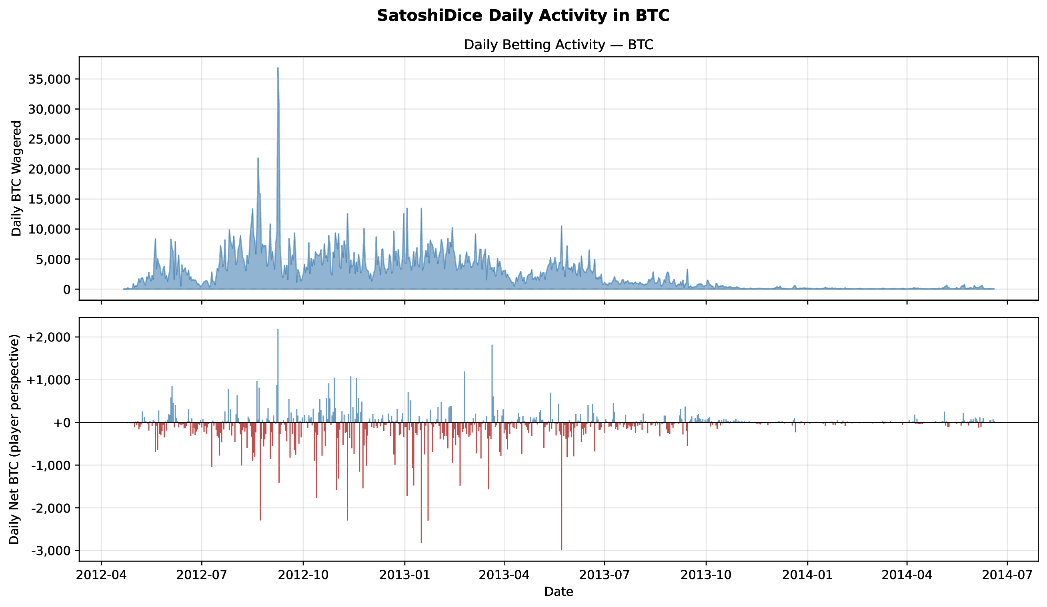
MOTIVATION
02
At peak, SatoshiDice turned Bitcoin into a gambling observatory
DATA WINDOW
BETS TRACED
WALLETS
2012-2014
4.68M
307,774
Notes:
Explain why SatoshiDice is analytically useful: bets are public, timestamped by blocks, and routed through known betting addresses. The point of the chart is scale, not fine detail.
Main activity period from 2012 to 2014
Almost 5 millions bets
Aaround 308 thousands wallet
Up to 35 thousands BTC spent in a day
Those transactions were predominanting the network
Let me start with why SatoshiDice is worth studying at all. "Online gambling has grown into a major global phenomenon, attracting millions of players and generating billions in economic flows." "In this context, blockchain technology has been used to support gambling services, aided by its properties, which guarantee unprecedented levels of transparency, anonymity, speed, and borderless access. A striking example in today's landscape is Polymarket, a blockchain-based prediction market where users can speculate on the outcomes of real-world events. Among these platforms, the first one to popularize gambling on blockchains was SatoshiDice, mostly active between 2012 and 2014, which emerged as one of the most influential services in the Bitcoin ecosystem, processing millions of bets and accounting for a significant fraction of all Bitcoin transactions during its peak activity period." Because every one of those bets is permanently recorded on a public ledger, SatoshiDice is effectively a complete, frozen gambling observatory. Our data window matches its active life exactly — 2012 to 2014 — and within it we trace 4.68 million bets across 307,774 wallets.

Slide 3
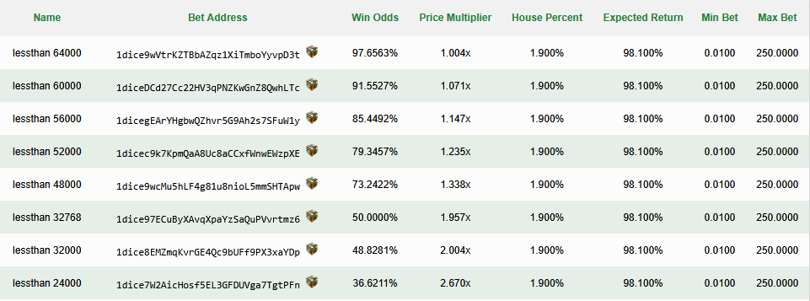
SatoshiDice
03
27 SatoshiDice betting addresses
Provably-Fair and Zero-Confirmation
Notes:
Addresses with probability
To win the random number must be less than X
Multiplier
Win percentage
Min to bet and max to bet signifying that there is a limit
4) Don’t TELL HOW IT WORKS BECAUSE WE don’t have time for this. Provably fair as the platform committed the secret to compute the random number the day after
Before the analysis, here's the mechanism. "A key innovation of SatoshiDice was its accountless and near-instant betting model. Users did not need to register or deposit funds into a custodial wallet. Instead, they simply sent Bitcoin directly to one of several published vanity addresses beginning with the prefix 1dice, each associated with a specific win probability and payout multiplier." The settlement was deliberately fast: "the platform relied on zero-confirmation transactions to preserve the rapid feedback loop central to gambling. Rather than waiting for a bet to be mined into a block, SatoshiDice monitored unconfirmed transactions in the mempool, computed the outcome immediately, and broadcast the corresponding response transaction. If the player received an incoming payment larger than the original stake multiplied by the relevant payout multiplier, the bet was won; otherwise, receiving only 1 satoshi, that is ten-to-the-minus-eight BTC, signaled a loss." And fairness was verifiable: "to compensate for the absence of traditional trust mechanisms, SatoshiDice adopted a 'provably fair' verification scheme." The platform committed to a daily secret key in advance, then computed each outcome deterministically with HMAC-SHA512 over that key — so any observer could recompute the result once the key was revealed.
Each address had a probability of winm a minimum bet and a maximum bet.
In fact there were some limitations on how much a single bitcoin address of a user was capable of spending

Slide 4

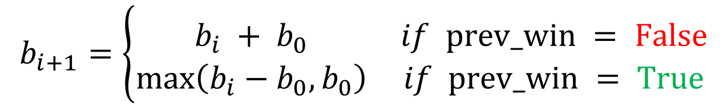
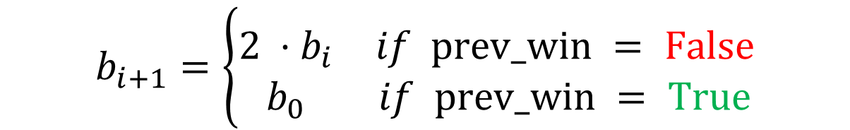
Betting Strategies
04
i: i-th bet-turn $b_{i}:bet at turn i{ b}_{0}:base bet$
Flat Bet:
$$b_{i+1}=b_{i}$$
$$b_{i+1}=\left\{\begin{aligned}&&&&&&& \\ \begin{matrix}2 ⋅b_{i} & if prev_win = False \\ b_{0} & if prev_win = True\end{matrix}\end{aligned}\right.$$
Martingale:
D'Alembert:
$$b_{i+1}=\left\{\begin{aligned}&&&&&&& \\ \begin{matrix}b_{i} + b_{0} & if prev_win = False \\ \max\left(b_{i}−b_{0},b_{0}\right) & if prev_win = True\end{matrix}\end{aligned}\right.$$
Notes:
Flat bet meaning always base bet
Martingale meaning multiply
D’Alembert additive base base
We study the three most famous betting systems. First, Flat Betting — and I quote: "This betting strategy entails maintaining a nearly constant bet size, independently of previous outcomes." It is the null hypothesis of betting: no reaction to wins or losses. Second, Martingale: "the expected behavior depends on the outcome of the preceding bet. After a loss, the bet is doubled; after a win, it resets to the base amount." We don't assume a flat 2× though — "in our adapted formulation, the progression is adjusted to the payout multiplier of the selected SatoshiDice address," using a recovery factor rho equal to m over m-minus-one. Third, D'Alembert, the gentler cousin: "the expected bet changes by one fixed base unit according to the outcome of the previous bet" — you add one unit after a loss, subtract one after a win. And a careful detail: "since D'Alembert reduces to Martingale in the case of a single loss followed by a win, we assigned to D'Alembert only bets that exhibited the additive progression at least twice, that is, with at least two consecutive losses," so the two strategies never overlap in our counts.

Slide 5
RESEARCH QUESTIONS
05
We test profitability and automation at the user level
Profitability
Automation
User-level
Do classic betting systems produce positive returns?
Measure net BTC/USD and streak profit rates.
Do betting sequences look manually executed?
Use block-height gaps and same-block runs.
Known SatoshiDice addresses identify wagers.
WalletExplorer clustering links Bitcoin addresses to user wallets .
Claim to test: strategy can beat house edge.
Claim to test: humans drove activity.
Unit of analysis: wallet-level behavior.
Notes:
1)Find out what strategy the users adopted and weather this allowed for sure profits
2) Expose bot activity by looking at the block height from each transaction
3) Do not look at the single Bitcoin address but cluster them to capture the range of Bitcoin addresses used by a user
This gives us two precise research questions, which I'll read exactly as they appear in the paper. "RQ1: does the systematic adoption of the well-known gambling techniques Martingale, D'Alembert, and Flat Betting lead to measurable monetary gains? RQ2: can behavioral and temporal patterns observed on-chain reveal the presence of automated betting agents, that is, bots?" The crucial methodological move behind both questions is this: "Previous research on Bitcoin gambling focuses on behavioral analysis at the address level, treating each Bitcoin address as an independent player. However, this approach fails to capture users operating multiple addresses, a common practice in Bitcoin." So we work at the wallet level, not the address level — that is our unit of analysis.

Slide 6
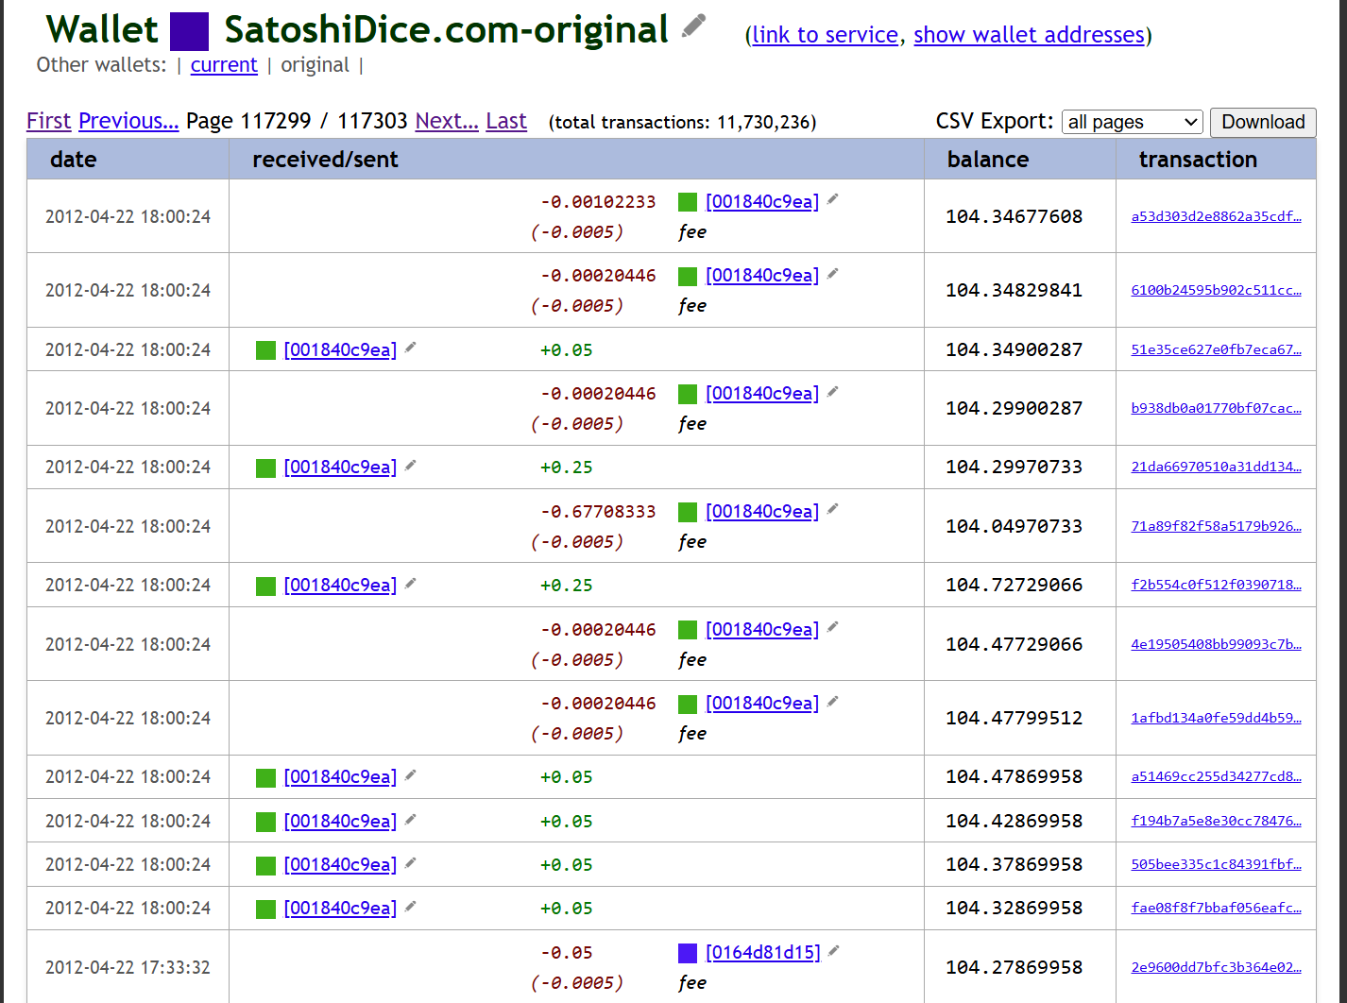
DATA CONSTRUCTION
06
Wallet clustering links 307,774 players to 4.68M bets
Pipeline
WalletExplorer.com multi-input clusters
Per-wallet strategy reconstruction
Win = payout ≈ stake × multiplier; Loss = payout of 1 satoshi
Pipeline code: github.com/caltr98/SatoshiDiceAnalysis
Dataset: 10.5281/zenodo.19512775
Notes:
Use as base the clustering done by Wallet Explorer
Classify a win as the stake multiplied by the win multiplier
Dust
How do we build a wallet-level dataset? "We address these gaps by introducing a user-level analysis framework that leverages the address clustering performed by WalletExplorer to reconstruct complete user activity profiles. By aggregating transactions across multiple addresses belonging to the same entity, we gain visibility into behavioral patterns that would otherwise remain fragmented and undetectable." Concretely, we combined three sources. One: "the full transaction histories of the main SatoshiDice wallet and its betting addresses were acquired via CSV downloads through a Selenium-based scraping pipeline." Two: "to obtain transaction-level blockchain data missing from the CSV, we exported them from our local full-node dataset spanning from 2012 to 2016" — this is where we get the block-height field we later need for bot detection. Three: "the WalletExplorer API was used to retrieve the missing fields for bets recorded by WalletExplorer between 2016 and 2025." Everything is merged into a local SQLite database. At the top level: "we covered 307,774 wallets and observed a global win rate of 44.45%, which includes bets to all 27 SatoshiDice addresses with all multipliers and outcome probabilities." The full pipeline and dataset are public on GitHub and Zenodo.

Slide 7
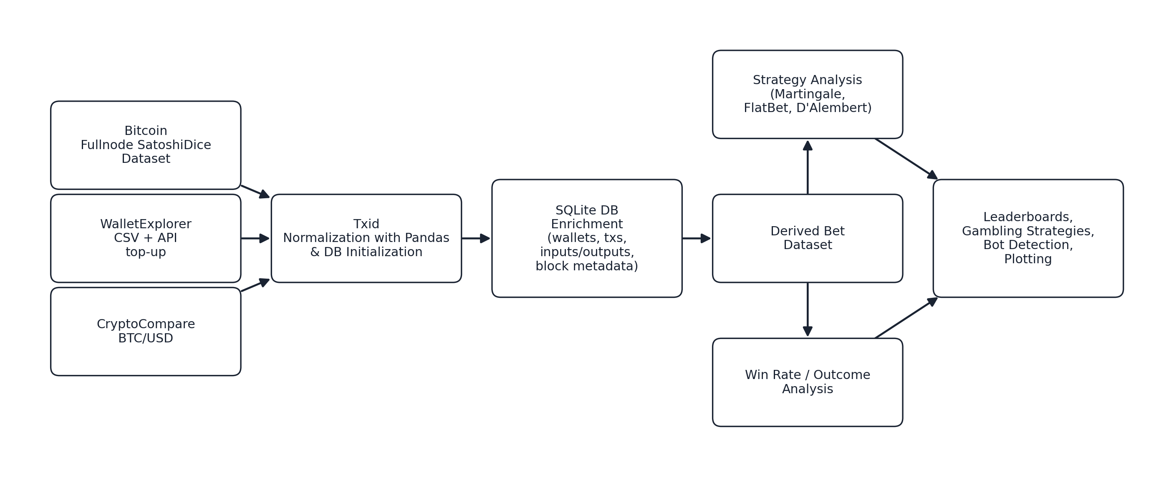
DATA CONSTRUCTION
07
The pipeline joins WalletExplorer, a full node, and strategy detection
Notes:
We used our own full node dataset, mapping the bets with WalletExplorer CSV, up until our dataset covered bets1
We used CryptoCompare platform data for mapping BTC to USD. Note that for each bet we calculated the amount is USD per the day of the bet.
We made a DataBase with SQLlITE TO store and retrieve the large quantity of data from disk in an aefficient manner
We run our analysis on strategy, winrate and automation
This figure summarizes that pipeline end to end. On the left are the data sources: the Bitcoin full node, the WalletExplorer CSV-and-API top-up, and CryptoCompare's daily BTC-to-USD closing prices. These feed into transaction-ID normalization and database initialization with pandas, then into the SQLite enrichment step that joins wallets, transactions, inputs and outputs, and block metadata. From there we derive the bet dataset, which drives two parallel analyses — strategy detection and win-rate analysis — and finally the leaderboards, gambling-strategy results, bot detection, and plotting. The CryptoCompare prices, importantly, are joined so that every BTC figure can be restated in the dollars of the day each bet was actually placed.

Slide 8
STRATEGY DETECTION
08
Progression rules leave deterministic fingerprints in the ledger
Flat betting
Martingale
D'Alembert
Constant stake
No progression
Loss: multiply stake
Win: reset to base
Loss: add one step
Win: subtract one step
12,484 wallets
10,909 wallets
211 wallets
Notes:
For each of the strategy, we found different number of wallets
Aroun 13 thousands with flat betting
Around 11 thousands for martingale
Only 211 for D’alembert
Now, how do we actually detect a strategy in a stream of raw transactions? Each progression rule leaves a deterministic fingerprint in the bet amounts, and we match it with a tolerance band that absorbs on-chain rounding and dust. Flat Betting we accept within plus-or-minus five percent of the previous stake; Martingale within plus-or-minus fifteen percent of the multiplier-aware expected stake; D'Alembert by its slow additive escalation. The streak rule is strict: "a sequence was recognized as a valid streak whenever it contained at least six bets following the proposed pattern of the corresponding strategy. We adopted this threshold to find meaningful streaks." Applying this across the whole dataset, we detect Flat Betting in 12,484 wallets, Martingale in 10,909 wallets, and D'Alembert in roughly five thousand wallets — so this is not a handful of anecdotes, it is a population.

Slide 9
STRATEGY DETECTION
09
Strategy adoption is uneven across the betting population
Flat Betting
Martingale
D'Alembert
1,096,010 strategy bets
23.40% of all bets
76,446 streaks
Streak Profit Rate 50.75%
Net -350.37 BTC
659,521 strategy bets
14.08% of all bets
54,747 streaks
Streak Profit Rate 66.78%
Net +7,845.28 BTC
3,047 strategy bets
0.07% of all bets
372 streaks
Streak Profit Rate 77.15%
Net -1,210.22 BTC
Net −$85.0K USD
Wagered: $10.07M USD
Net +$78.1K USD
Wagered: $6.89M USD
Net -$38.0K USD
Wagered: $83.4K USD
Notes:
We detected that out of all analysed bets, Flat Betting was around the 23% of them, note that the net gains in BTC and USD were negative (meaning that
For Martingale the analysis showed that still significant number of bets followed that pattrern
For D’Alembert we found that only bets bets in number followed that pattern, with oly few dollas wagered, as such we cannot deduce much abaout analysisng that strategy, thus we discuss in depth
Flat Betting and Martingale
Strategy adoption is uneven. Flat Betting: 1.1 million bets — 23.4% of everything. Martingale: 660,000 — 14%. D'Alembert: only 3,000 — 0.07%.
More than a third of all bets follow one of these three classical progressions — striking for an anonymous, accountless platform. The streak profit rates already hint at the punchline: Flat is at 50.75%, Martingale at 66.78%. We'll see what those numbers mean in a moment.

Slide 10
Finding 1
The house edge survived the Flat Bet strategy
Wins and losses even out, the house keeps its cut
Notes:
So, Finding 1, stated plainly: the house edge survived every strategy. In the words of the paper's conclusion, "neither more disciplined betting progressions using strategies significantly overturns the house advantage." The single most important idea on this slide is the distinction we're about to unpack: winning more streaks is not the same as making money.

Slide 11
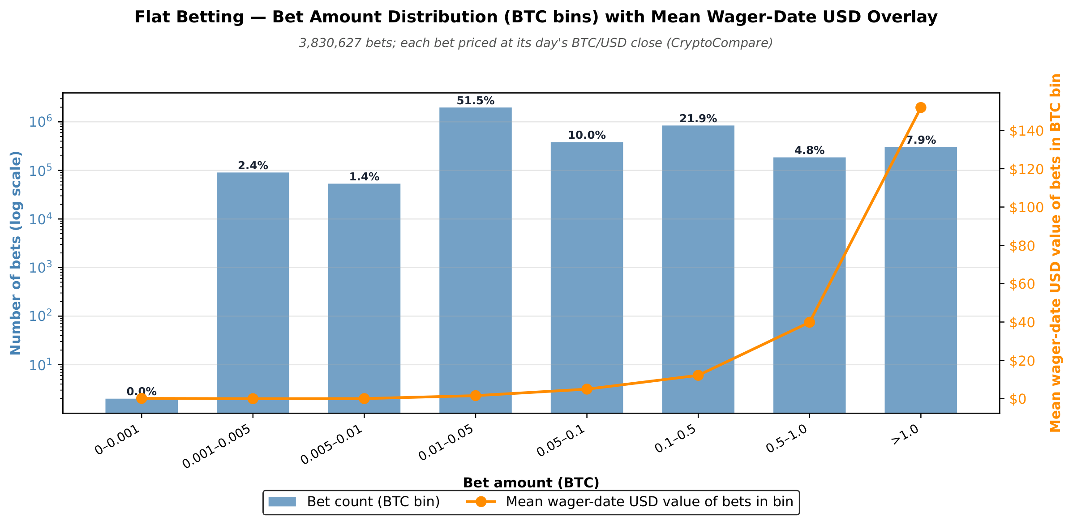
RESULTS
11
Flat betting limited risk behaviour
Flat betting
Streak profit rate: 50.75%
Net outcome: -350 BTC
Approx. real value: -$85K
Wallets detected: 12,484
Notes:
1) Here we see the base bet amount, generally a modest amount of BTC were bet, in the 0.01-0.5 range. In Particular bets did not go above 20$ at the moment of the wager
Take Flat Betting first. Across the top gainers and losers, "there is no apparent pattern in the number of bets or the number of separate streaks that led to positive net profit/loss." And the headline number tells the story: "given the analysis and the Streak Profit Rate of 50.75 percent, namely the share of streaks with a positive net profit/loss, we conclude that Flat Betting streaks were roughly as likely as a random throw to end in profit or loss." The net result is minus 350 BTC. The paper's verdict: "Flat Betting did not emerge as a systematically effective strategy, while we notice significant efforts in pursuing gains using it." Flat betting is, statistically, just a coin flip — and the house edge does the rest.

Slide 12
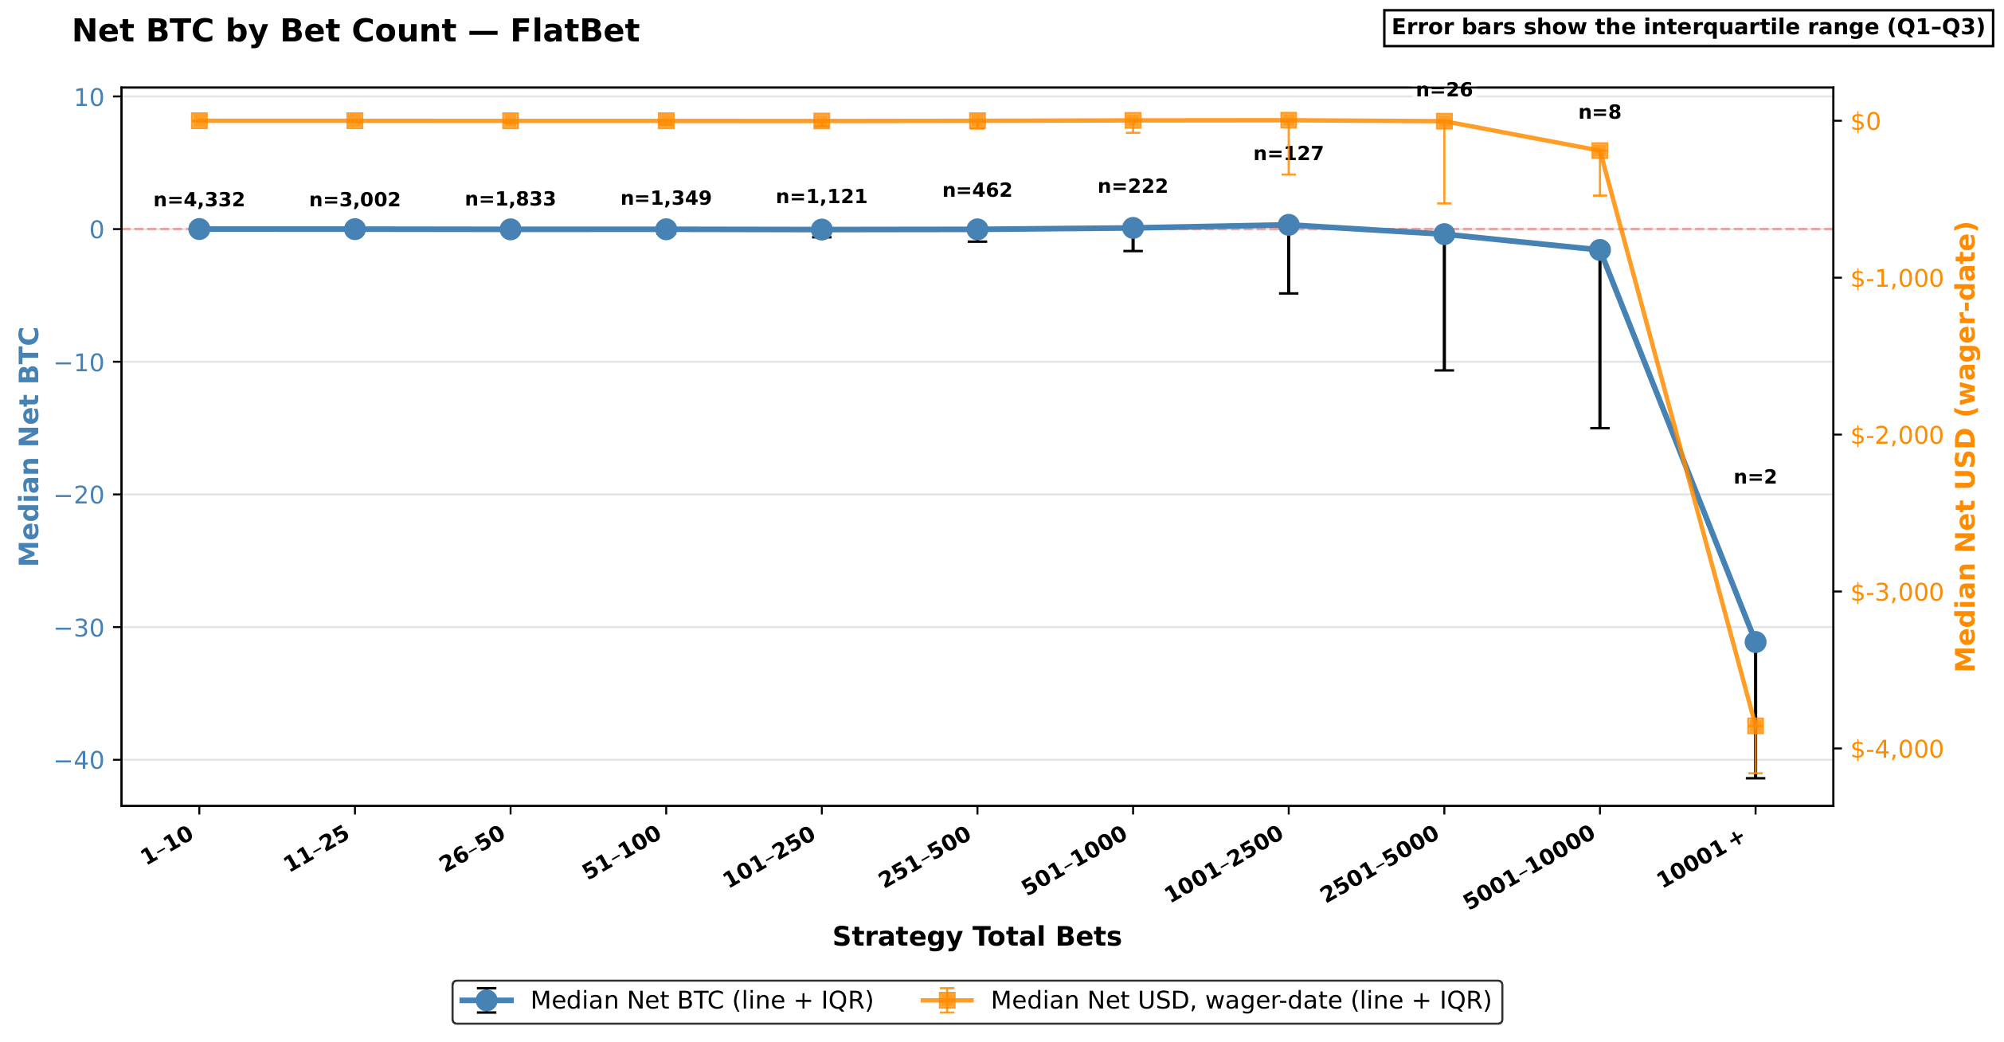
RESULTS
12
Flat betting behaves like chance, then loses to the house edge
Notes:
This graph shows the Media NET BTC depending on the length of a Streak of Bets.
It appears that losses even out with wins
However it seems that the few long bets going above 2000 consecutive streak betts arrived to negatives in terms of BTC and USD
This is the per-wallet picture, binned by how many strategy bets a wallet placed, with the blue line in BTC and the orange line restating the same medians in wager-date dollars. The finding is almost counterintuitive: "the lack of commitment to the strategy was not a factor in increasing net profit/loss; on the contrary, the two wallets with the highest number of streak bets exhibited a highly negative median Net BTC. Thus, while wallets generally remained around zero median Net BTC, as gains and losses broadly offset each other, exposure to risk at a high number of bets suggests increased losses from at least 2,500 bets." So playing more did not help — if anything, the heaviest players bled the most, and the dollar overlay tracks the same downward shape.

Slide 13
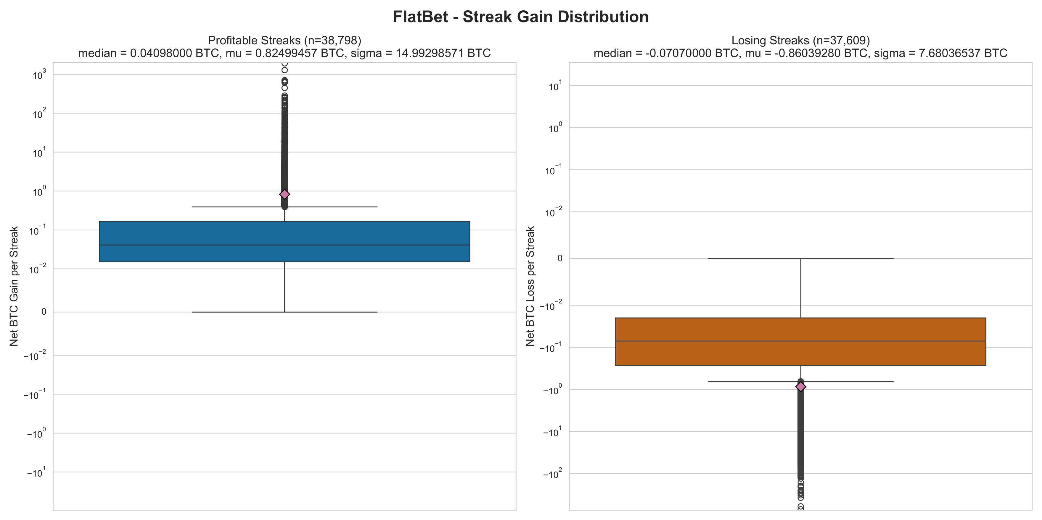
RESULTS
13
Flat Bet distribution of profits and losses
Notes:
Here we can see the NET BTC gains per streak that were able to turn a profit and the NET BTC losses for streaks that resulted into a loss
We generally observed that winning streaks even out with losing streaks as the losses and wins are around the same intervals,
Two more descriptive facts about Flat Betting. On bet sizing: "the highest number of betting streaks started with an amount of BTC from 0.01 to 0.05 BTC" — these were small, low-stake streaks. And on outcomes, the win-versus-loss boxplot is essentially symmetric: the paper notes "comparable wins and losses median and average in only the winning streaks and losing streaks, respectively." That symmetry is exactly why a 50.75 percent profit rate means chance and not skill — the wins and the losses are the same size, so over time the edge wins.

Slide 14
House edge survived with some hits against Martingale
Finding 2
Recouping losses was not feasible in the long run for everyone
Notes:
Let us see on weather Martingale was better in getting profits and offsetting losses
Now the strategy people actually believe in: Martingale. And here I want to be fair to it before I take it apart. "Martingale, by contrast, may appear less naive, as its more frequent profitable streaks can create the impression of a strategy capable of taming uncertainty and delivering more stable gains." It genuinely wins more often. But the point of this slide is: recouping losses is not enough. Let's see why.

Slide 15

RESULTS
15
Martingale rotates addresses to keep going
Martingale
Streak profit rate: 66.78%
Net outcome: +7,845.28 BTC
Approx. real value: +$78.1K
Wallets detected: 10,909
Bet SatoshiDice address change: 16,080
Notes:
The base bet amount is similar to Flat Bet, showing that the users were cautious
Users changed address on where to bet, rather than only increasing the straked amoumt, in this way the were able to using the same stake have the multiplier behaviour of obtaining double the amount of BTC for a win, they did this for 16 times.
Martingale's Streak Profit Rate is 66.78 percent — two out of three streaks end in profit — and its aggregate net is positive, plus 7,845 BTC. At first glance this looks like the strategy that works. But two caveats. First: "wallets following the Martingale avoided large losses, as for streaks of up to 1,000 bets the median remained centered around zero BTC… even if the interquartile range indicates substantial variability around the median." Second, and decisively, that positive aggregate is carried by a thin tail of large wallets — the median wallet still does not come out ahead.

Slide 16
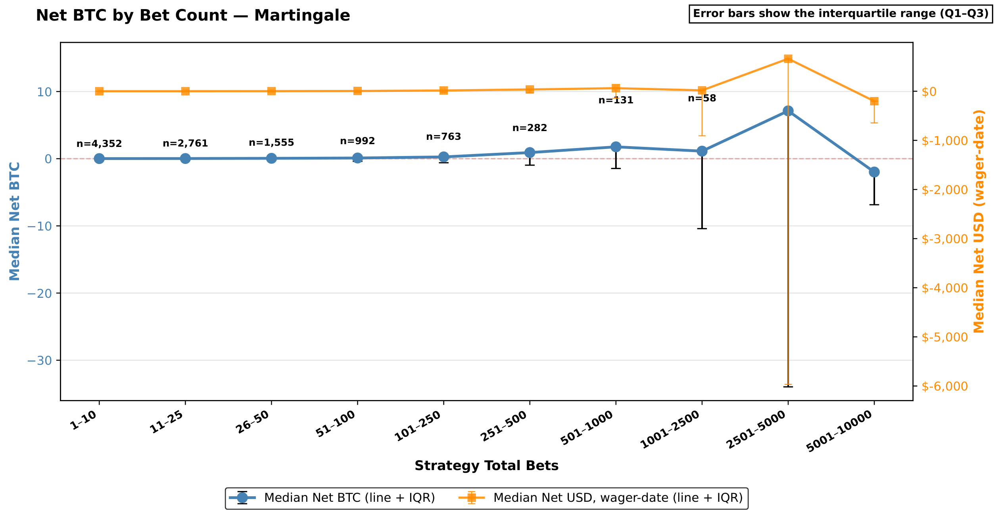
RESULTS
16
Martingale wins streaks, but its losing streaks are larger
Notes:
In this case the trend is also evened out, howerr the actors that were able to stick to long streaks were able to turn a profi
Note however that not all of them were lucky enough with heavier losses to -30 BTC which amounted at the moment of betting to around 6k$ in losses
Now the strategy people actually believe in: Martingale. And here I want to be fair to it before I take it apart. "Martingale, by contrast, may appear less naive, as its more frequent profitable streaks can create the impression of a strategy capable of taming uncertainty and delivering more stable gains." It genuinely wins more often. But the point of this slide is: recouping losses is not enough. Let's see why.

Slide 17
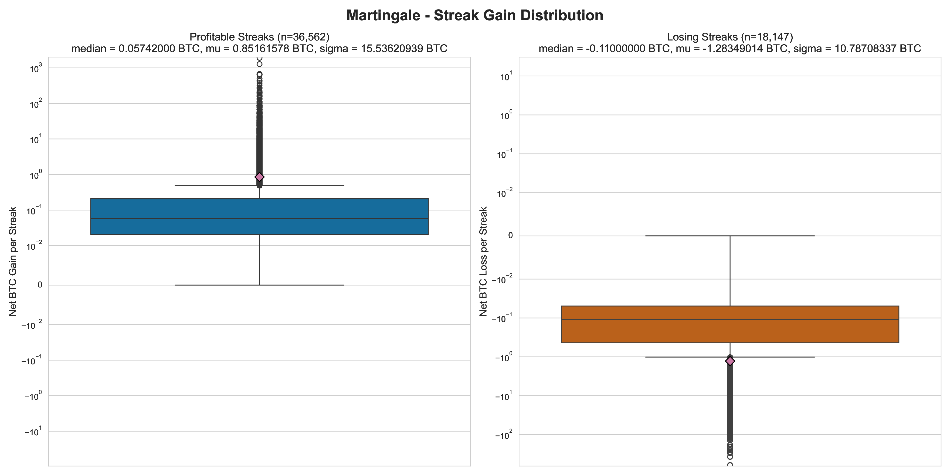
RESULTS
17
Martingale distribution of profits and losses
Notes:
1) Regarding the profits and losses in winned and lost streak,s as before the wins were equivalent to the losses
And here is the catch that defeats the strategy, straight from the paper: "while profitable streaks yield a positive average gain of 0.85 BTC per streak, losing streaks are, on average, more punishing, with a mean loss of 1.28 BTC. In other words, although the strategy can occasionally bloom into profitable runs, more than Flat Betting, on average players are exposed to substantial risk of BTC losses." So the wins are frequent but small, and the losses are rare but roughly fifty percent larger. The conclusion ties it off: "this advantage is only partial and temporary, since the higher likelihood of short-term profit remains coupled with losses severe enough to erase those gains. Furthermore, Martingale, while theoretically capable of recovering losses, becomes impractical when the player's funds are insufficient to sustain the required doubling sequence." That is the Martingale trap, made visible on-chain.

Slide 18
Finding 3
Same-block timing exposes automation
The strongest signal is not profit; it is execution speed.
Notes:
1) Let us see on checking for bots what were our results
That brings us to the second half of the paper, and to me the more surprising half. Finding 2: same-block timing exposes automation. The strongest signal in this entire dataset is not profit — it is execution speed.
That brings us to the second half of the paper, and to me the more surprising half. Finding 2: same-block timing exposes automation. The strongest signal in this entire dataset is not profit — it is execution speed.

Slide 19
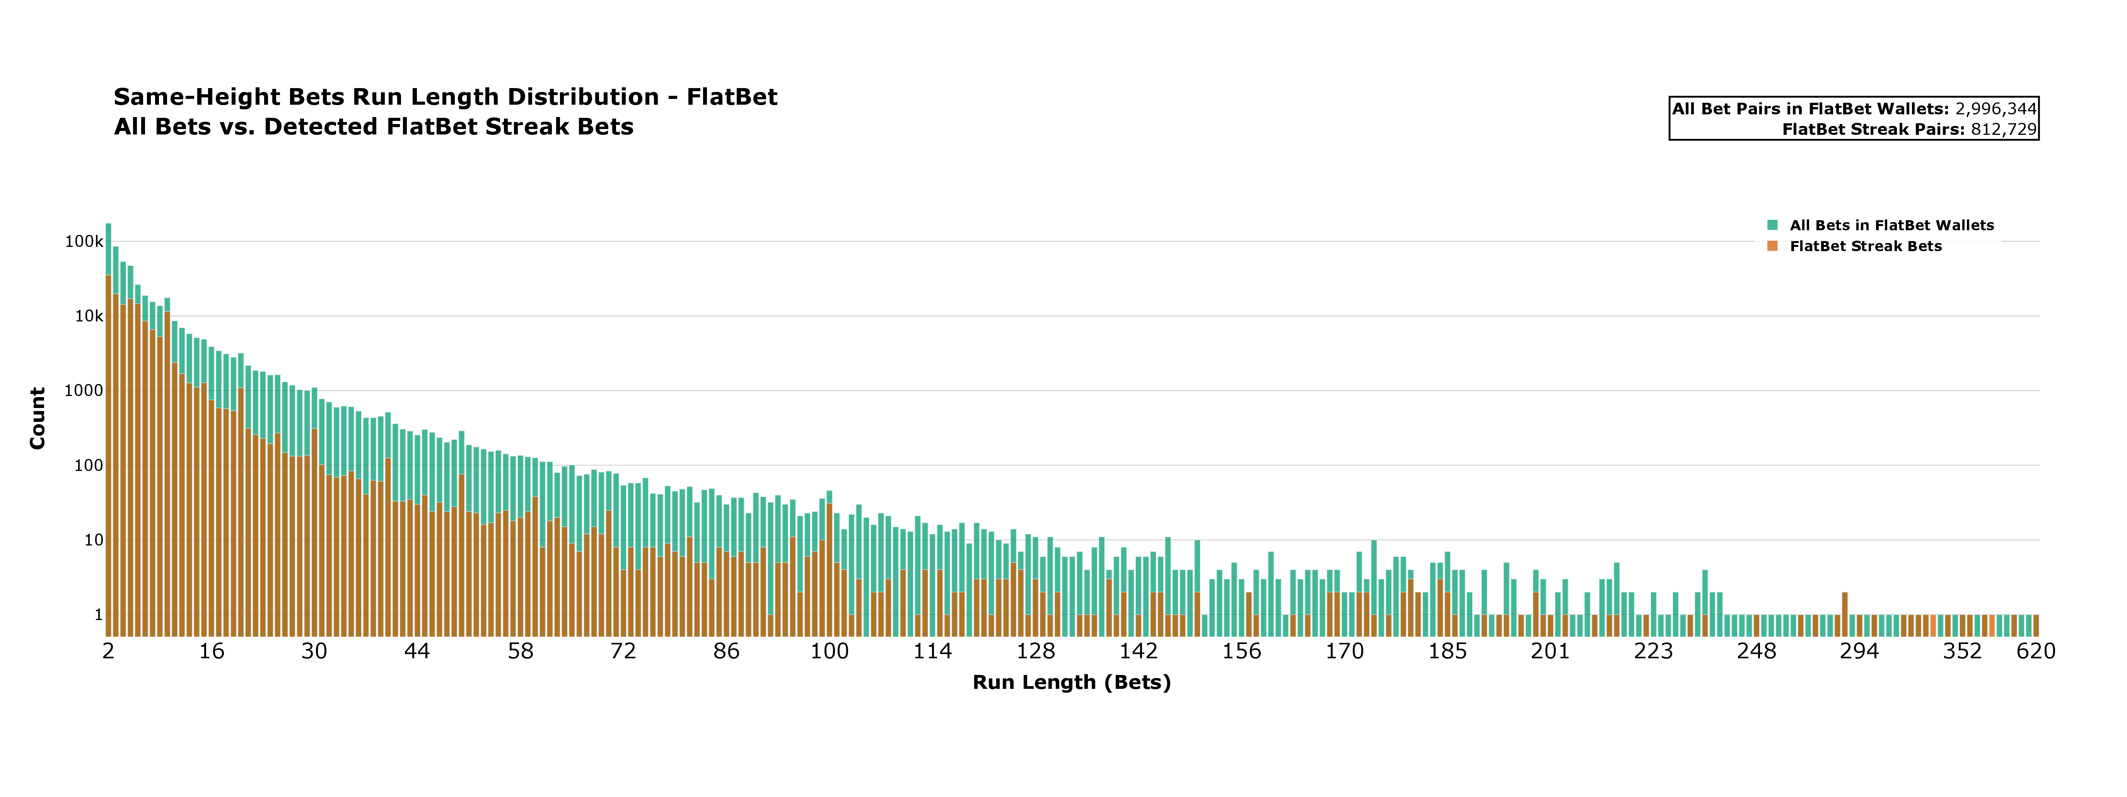
TIMING EVIDENCE
19
Same-block runs reach hundreds of consecutive bets
Flat Betting
Notes:
Here we plot the number of bets that were mined in the same block. The red lines highlight in the wallets flagged to have flat bet behaviour the number of bets of flat bet or not but placed together
Green lines are the bets of wallets flagged
We discern the same block with block height rather than timestamp, as Bitcoin miners could chose arbitrary timestamps and in the Bitcoin network blocks timestamp are not a correct and sequential per block
For flat bet now how there were cases in which 620 consecutive ebts were placed
But also having more than a set amount of same bets blocks, for instance 30 shows autometed activity
And this is the smoking gun. We look at runs of consecutive bets mined in the exact same block — a block-height distance of zero. "For Flat Betting, a large share of the detected behavior is concentrated at short run lengths, with substantial mass still visible around 16 consecutive same-block bets, while some runs extend much further, up to 620 consecutive bets. Martingale exhibits a similar pattern… with some same-block runs also reaching 620 bets." The paper's conclusion about these is unambiguous: "these exceptionally long within-block sequences are difficult to reconcile with manual play and instead support the presence of automated betting bots." No human places 620 bets inside a single ten-minute block.
620 consecutive bets in one block

Slide 20
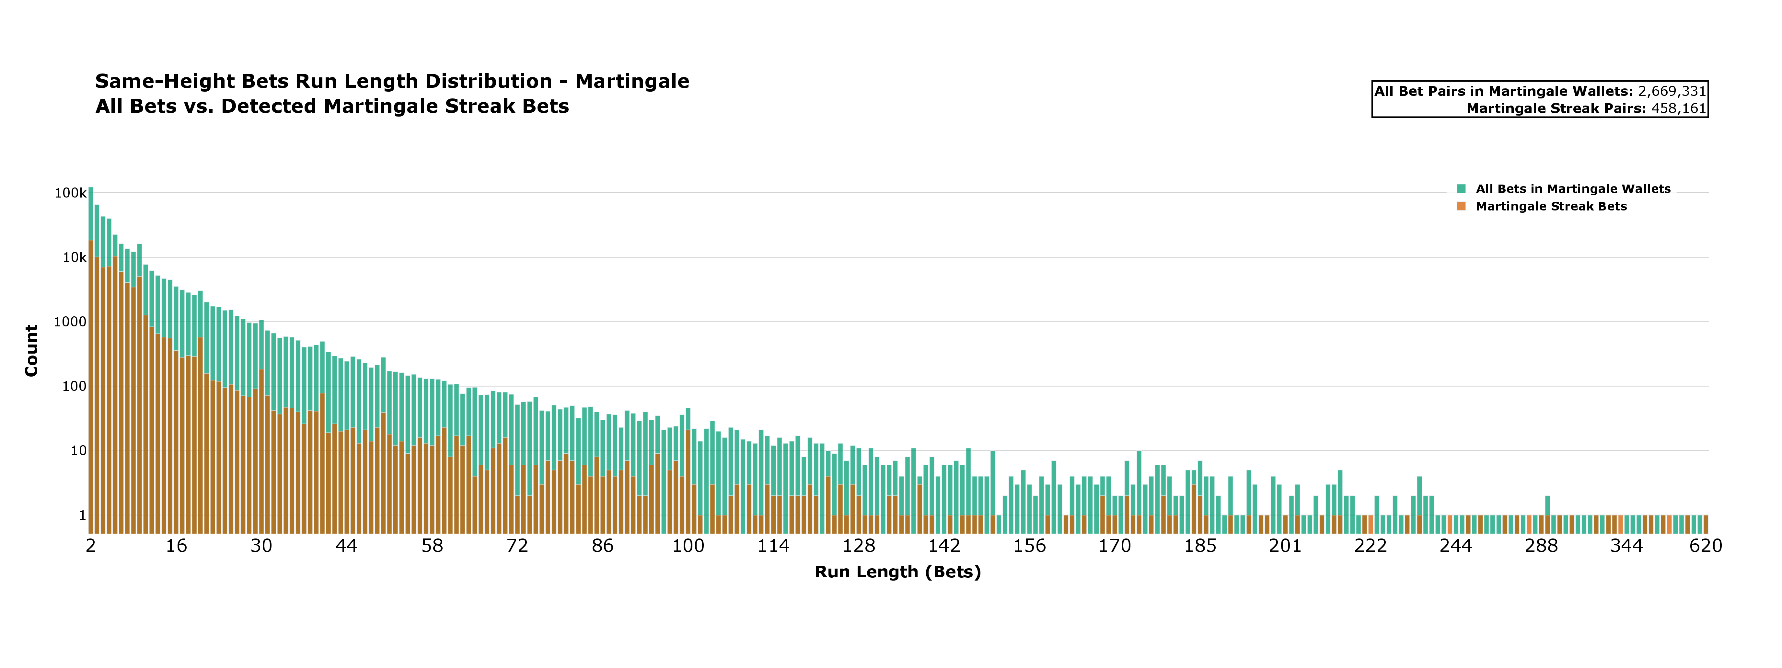
TIMING EVIDENCE
20
Same-block runs reach hundreds of consecutive bets
Martingale
Notes:
This is the plain-language automation slide. Consecutive bets inside a single block, in runs as high as hundreds, are incompatible with manual interaction.
Slide 20 — "Same-block runs reach hundreds of consecutive bets"

Slide 21
TAKEAWAYS
21
The answer is simple: no strategy beats edge; bots dominated activity
No betting system beat the house edge
Automation is visible on-chain
Flat betting: -350 BTC
Martingale: wins more streaks, losses are not recoverable
Across strategies, losses dominate wallet outcomes
Same-block bets are common
Runs reach hundreds of consecutive bets
Timing evidence complements profit evidence
Notes:
So let me bring the two findings together. On RQ1 — did the strategies pay? "No strategy emerges as a reliable path to sustained profit." "Flat Betting appears as a clear fool's errand: players moved large quantities of BTC without any meaningful progression in profit, remaining exposed to near-even odds without materially improving their position." Martingale's edge "is only partial and temporary." On RQ2 — were there bots? "Our analysis suggests that systematic betting patterns were frequently accompanied by automated behavior, although no fail-proof winning method emerged from them." And stepping back: "this approach shows that the underlying asymmetry of the game remains intact, even when players attempt to circumvent human betting consistency limits by using bots together with systematic strategies."

Slide 22

Conclusions and Next Steps
22
On-chain betting turns every wager into observable data for pattern analysis
Time-series shapelets & discords for anomalies and pattern detection.
Find and apply suitable Machine Learning Techniques for Bot Detection
Polymarket Analysis
Pipeline code: github.com/caltr98/SatoshiDiceAnalysis
Dataset: 10.5281/zenodo.19512775
Notes:
I'll close with the line the paper itself closes on: "This work serves as a cautionary tale for on-chain betting systems, which have remained popular from Bitcoin's inception to contemporary platforms such as Polymarket or Kalshi." As future work, "we plan to study on-chain betting behavior on modern platforms, with a particular focus on Bitcoin price prediction markets on Polymarket… through betting time-series and bot-detection techniques," including time-series analysis with shapelets and discords. Thank you very much for your attention — I'd be glad to take your questions.

Slide 23

No betting system beat the house edge on SatoshiDice and the highly disciplined betting activity is a clear indication of bots, yet even automation produced no reliable path to profit.
Thank you!
Questions?
calogero.turco@phd.unipi.it
Notes:
No betting system beat the house edge on SatoshiDice — and the disciplined betting we detected was largely run by bots, yet even automation produced no reliable path to profit.

Slide 24
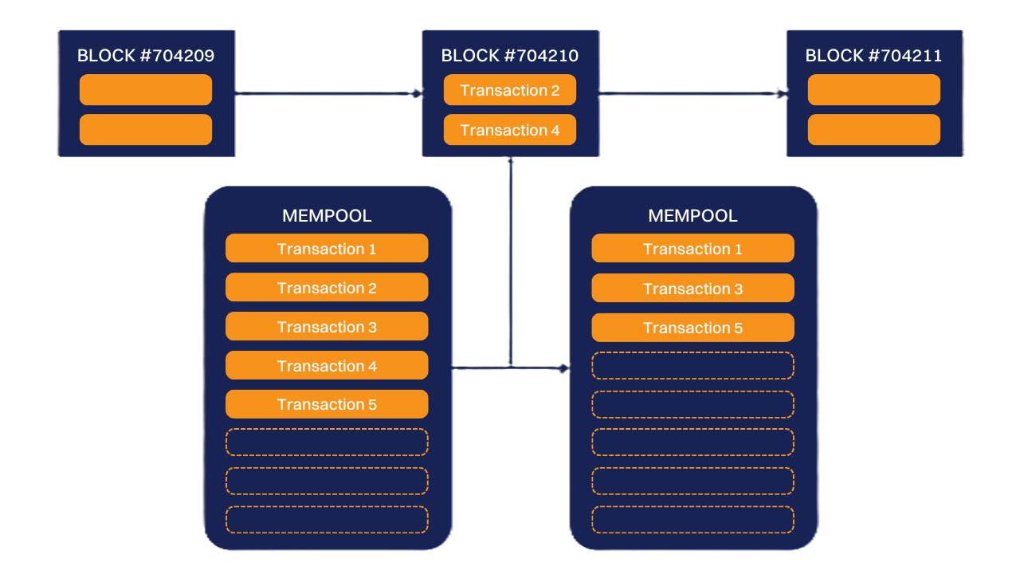
Provably Fair
Zero-Confirmation Transactions

Slide 25
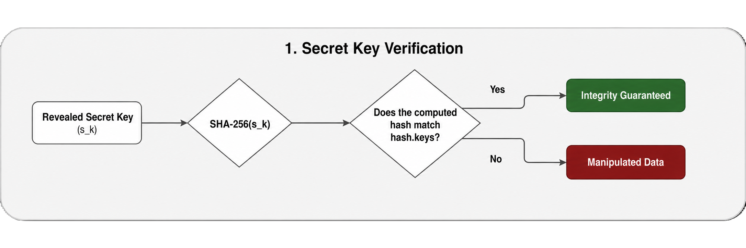
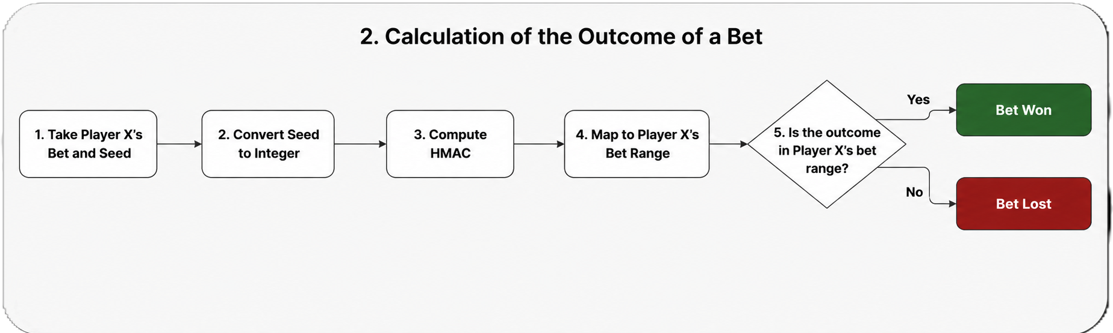
Provably Fair

Slide 26
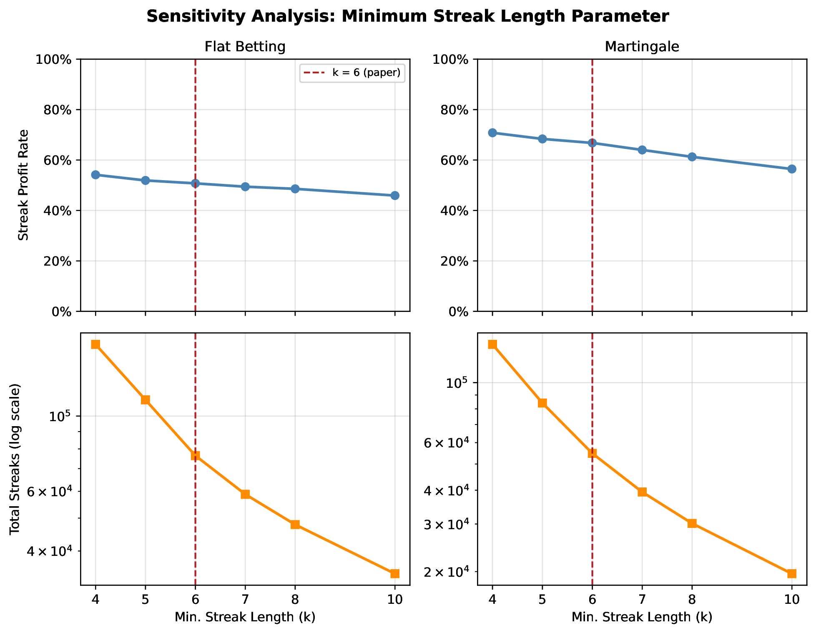
SENSITIVITY
15
The strategy counts and bot signals are stable across k
Notes:
Before the results, let me pre-empt the obvious objection — why six bets, and not five or ten? We re-ran the entire analysis across a range of thresholds, and the figure shows the answer: "the relative ordering of the three strategies and the Streak Profit Rate remain stable when k is varied across four, five, six, seven, eight, and ten, so this choice does not drive the conclusions." As you'd expect, the share of bets that qualify decreases as the threshold tightens, but the qualitative story — which strategy looks best, which looks like chance — does not move. The choice of six is a representative middle of that range, not a number we tuned to get a result.

Slide 27
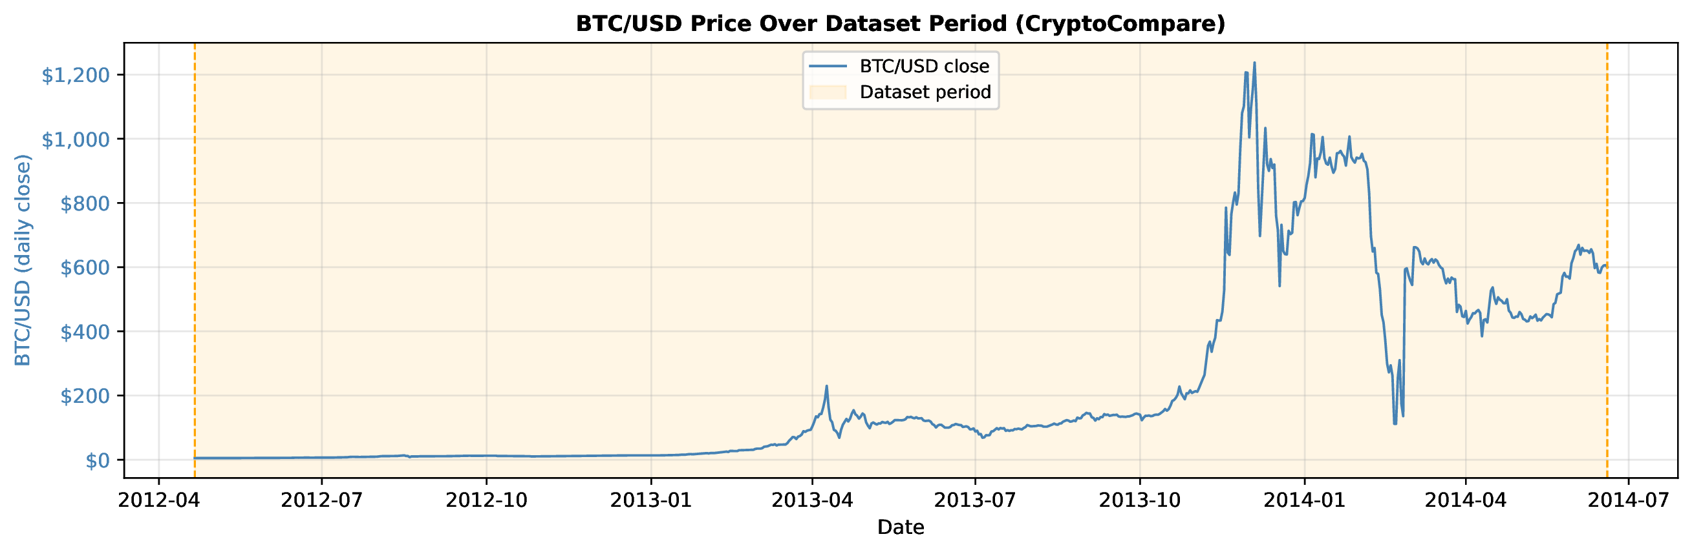
ECONOMIC CONTEXT
10
Dollar conversion changes scale, not the statistical story
Notes:
A quick but important methodological note on dollars. Net BTC depends on the Bitcoin price the day each bet was placed, and that price moved by orders of magnitude across our window. So rather than apply one average exchange rate, we convert every individual bet at its own wager-date BTC-to-USD close from CryptoCompare and sum. The paper is deliberately careful here: "ROI is price-independent and remains the primary reference; the USD restatement is reported only as a sanity-of-magnitude check that preserves the BTC-level conclusion." In other words, the dollar view changes the scale you see, but it does not change the statistical story — the ranking and the sign of every result hold.

Slide 28
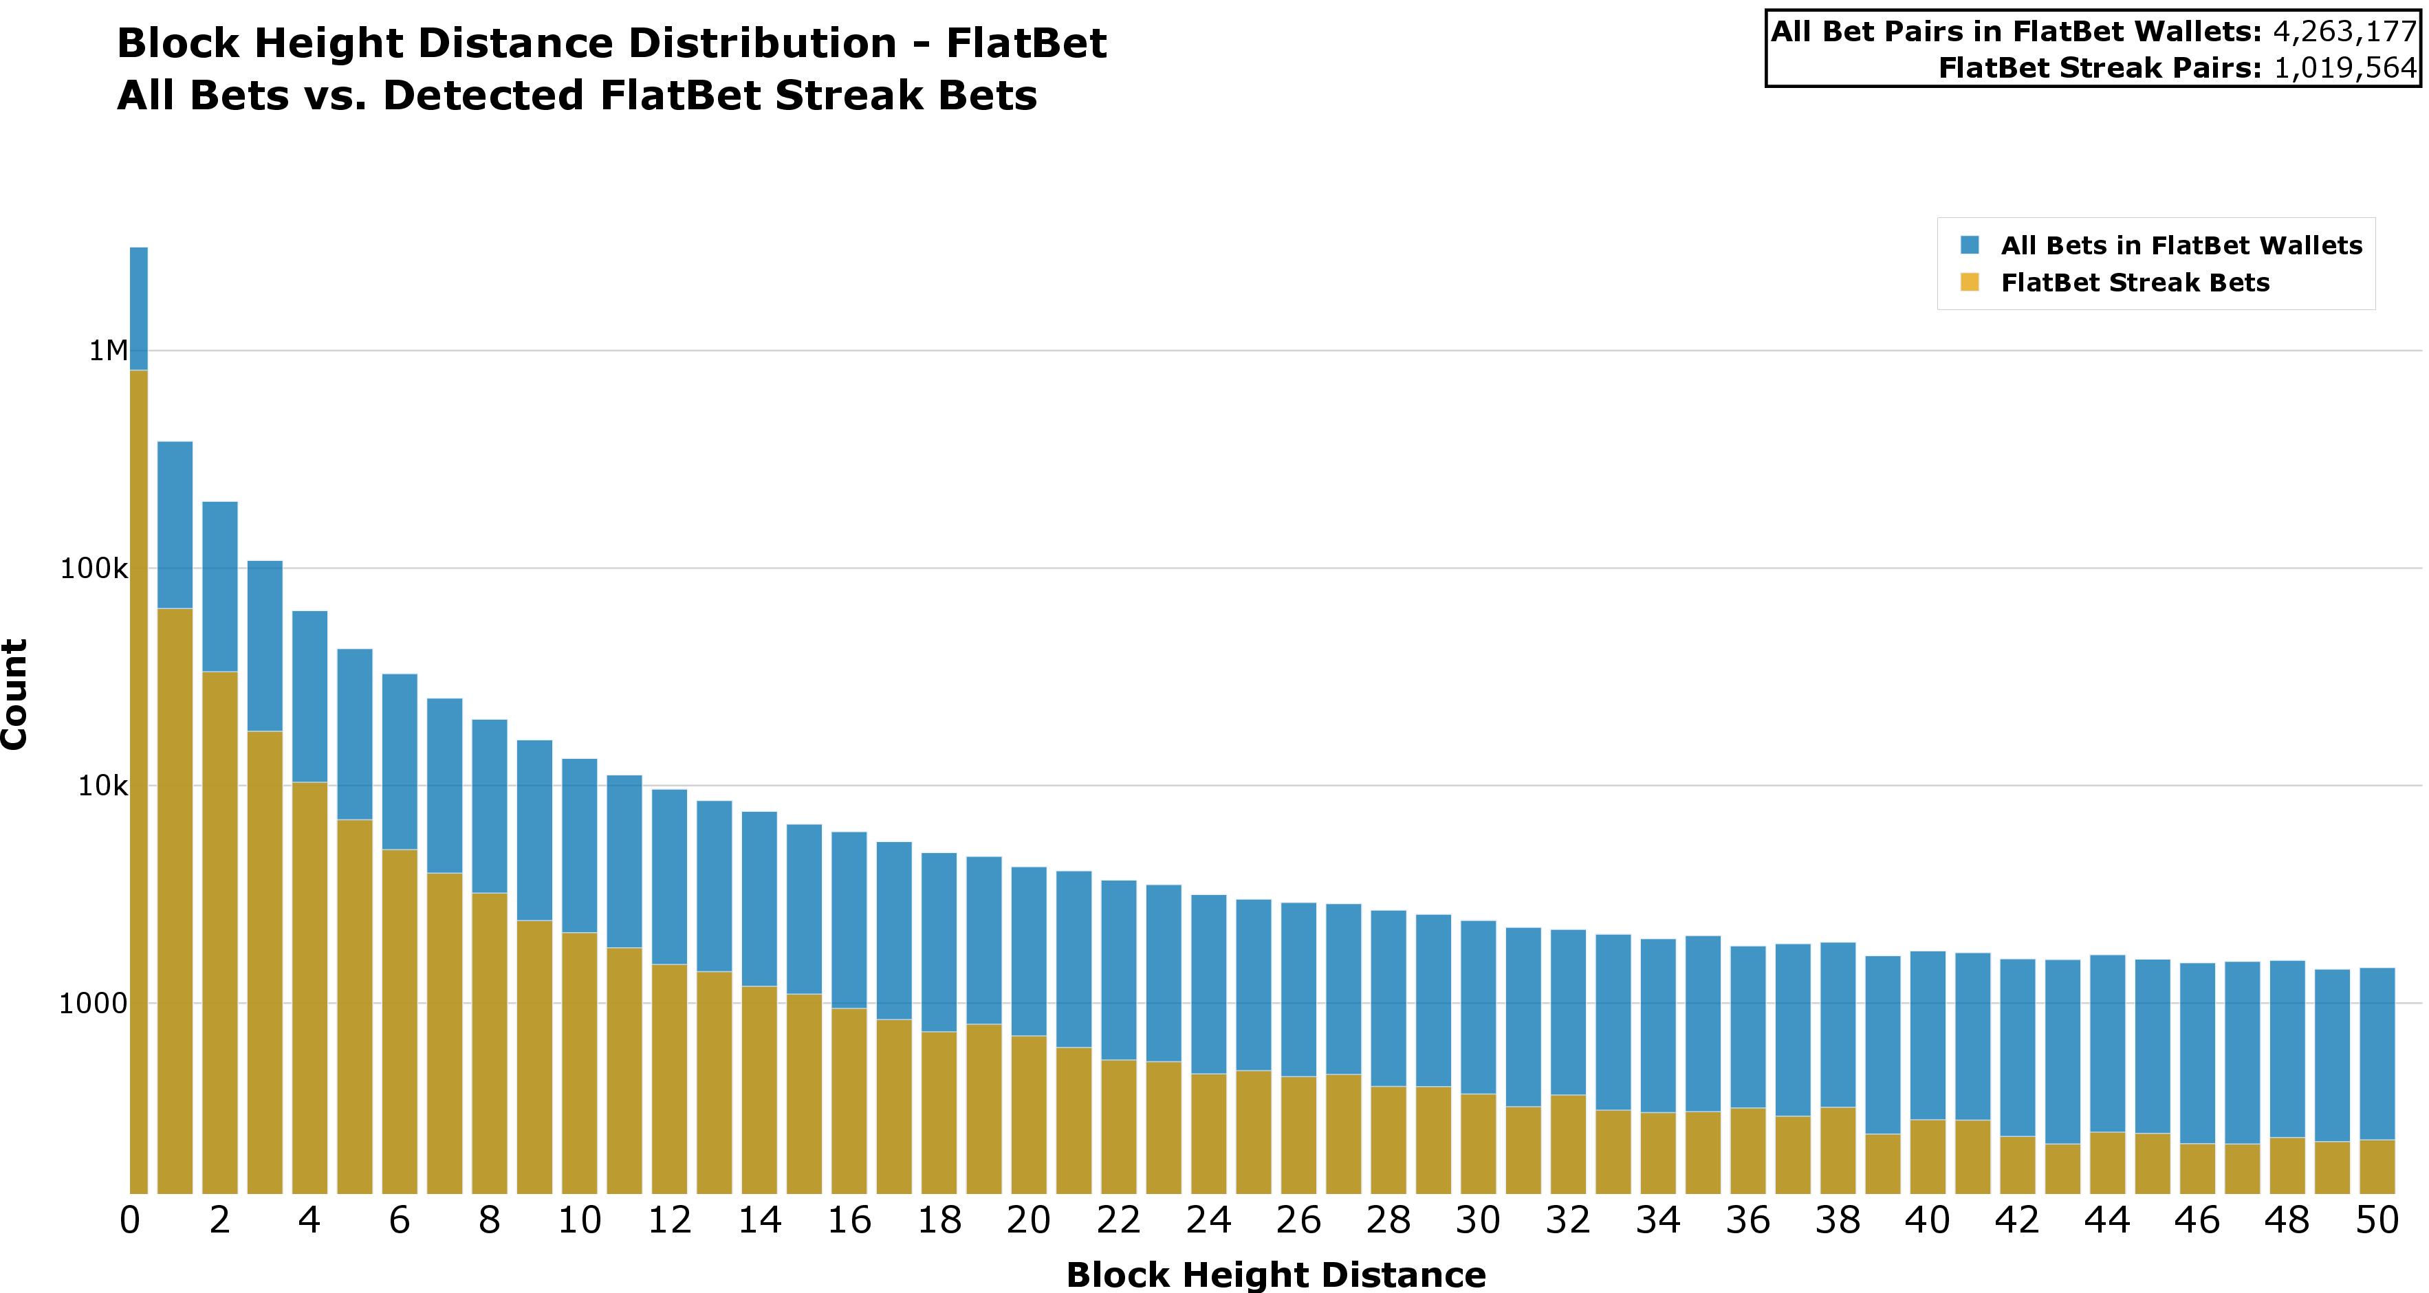
TIMING EVIDENCE
12
Many strategy bets arrive in the same block
Notes:
Here's the reasoning. "It is apparent that, given the large number of streaks, with some individual streaks exceeding ten bets, some form of automated behavior may have been involved. To investigate this, we isolate the block_height field of each bet transaction, noting that it is one of the main available on-chain indicators that two bets were mined together or in close succession. The reason is that information such as timestamp is not fully reliable, as it is set by the miner and can be modified within certain bounds." When we measure the block-height gap between consecutive bets, the result is stark — and these are the Table 6 numbers: general activity averages 86.27 blocks between bets, Flat Betting streaks just 44.22, and Martingale streaks only 14.94. "Both Flat Betting and Martingale exhibit substantially lower mean distances and standard deviation than the general case, indicating that bets within detected streaks tend to be mined much closer together than ordinary betting activity and in a more consistent manner." Faster, and more regular — the dual signature of a script.

Slide 29
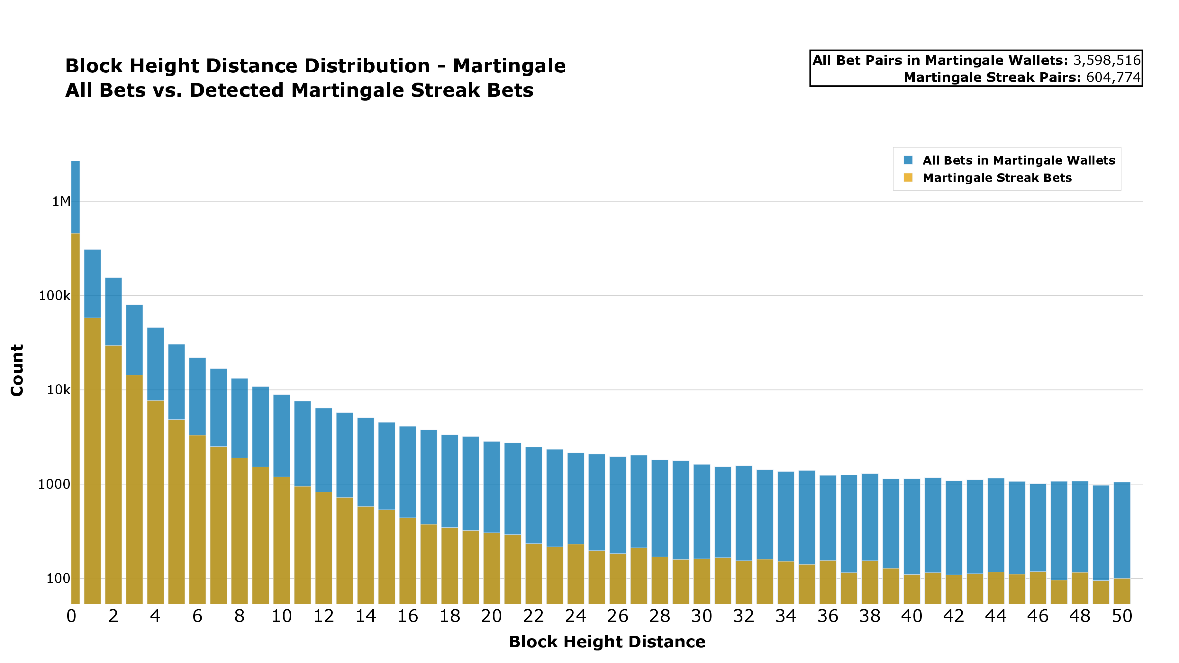
TIMING EVIDENCE
12
Many strategy bets arrive in the same block
Notes:
Define the timing measure: distance in block heights between consecutive bets by the same wallet. A mass at zero means repeated bets within one mined block.

