Slide 1


BlockCold: AI and Blockchain for Secure IoT Food Cold Chains Monitoring
DLT Workshop
DLT2026 Pula (Cagliari), Italy June 4–6, 2026
Azmat Ullah
azmat.ullah@unicam.it
University of Camerino
Italy
Antonio Pierro
antonio.pierro@unica.it
University of Cagliari
Italy

Slide 2
Motivation & Problem Statement
Dairy products like cheese are highly sensitive to temperature and humidity fluctuations throughout the cold chain.
Regulation EC 853/2004 requires strict traceability and accountability across all stages of the supply chain.
Traditional systems use manual checks or simple threshold loggers missing gradual faults like compressor wear or subtle statistical deviations.
Food Safety
EU Compliance
The Gap
2

Slide 3



The BlockCold Solution
Three innovations that outperform traditional rule-based monitoring systems
01 Edge AI
02 BLOCKCHAIN
03 HARDWARE
Edge Isolation Forest
IOTA Tangle
TROPIC01 Secure Element
Unsupervised anomaly detection, no labeled fault data required. Inference in < 1 ms on Raspberry Pi 4B.
Fee-free DAG ledger allows up to 2,880 signed submissions/day. Immutable, publicly verifiable audit trail.
ECDSA P-256 signing on-chip. Private keys never leave the hardware boundary, immune to OS compromise.
3

Slide 4
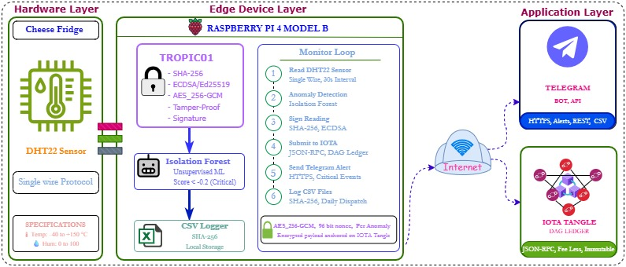
System Architecture
Figure 1: BlockCold System Architecture
Hardware Layer
Edge Device Layer
Application Layer
DHT22 Sensor
TROPIC01 Secure Element
Raspberry Pi 4B
Isolation Forest (< 1 ms)
SHA-256 + ECDSA Signing
Local CSV Logging
IOTA Tangle (fee-free DAG)
Telegram Bot Alerts
Daily CSV hash anchoring
4

Slide 5
Edge-Based AI anomaly Detection
Algorithm: Isolation Forest (iForest) unsupervised ensemble that requires zero labeled fault data.
Feature: Temperature, Humidity space detects unusual combinations even within the individually safe range.
Training Parameters: 10,241 readings, n_estimators=100, contamination=0.05, trained directly on deployment data.
Speed: Inference in < 1 ms per reading on a Raspberry Pi 4B, suitable for real-time edge computing.
Key Advantages: Catches 147 in-range deviations that rule-based systems completely miss.
< 1 ms
inference latency
5.0%
anomaly rate (512 readings)
147
in-range-only anomalies
5

Slide 6
Hardware Level Security
Private keys never leave the hardware boundary even if the host OS is fully compromised
SHA-256 Hashing: Deterministic JSON payload hashed before signing. Ensures any tamper attempt is immediately detectable.
ECDSA P-256 Signing: Industry-standard elliptic curve digital signature. 64-byte signature returned; proves who created the data.
AES-256-GCM Encryption: Encrypted payloads with a 96-bit nonce per anomaly anchored on IOTA Tangle. Hide the data from unauthorised eyes.
OS-Compromise Resilient: Software-based signing is vulnerable to key extraction via debug interfaces, TROPIC01 eliminates this risk.
DHT22
Sensor
Raw reading
→
Serialize JSON
SHA-256 hash
Raspberry Pi
Edge Device
→
TROPIC01
Secure Element
ECDSA P-256
Key stays inside
→
IOTA
Tangle
Permanent
on-chain anchor
6

Slide 7
Ledger Integration IOTA
Tangle
Immutable Audit Trail: (Every anomaly record contains timestamp, temperature, humidity, anomaly score, SHA-256 hash, and ECDSA signature permanently on-chain.
Fee-Free Anchoring: DAG-based IOTA Tangle enables up to 2,880 submissions/day at zero cost, making high-frequency IoT logging economically viable.
Proof-of-Existence: Daily CSV logs are hashed and anchored to the Tangle every 24 hours, enabling third-party verification of historical data integrity.

Slide 8
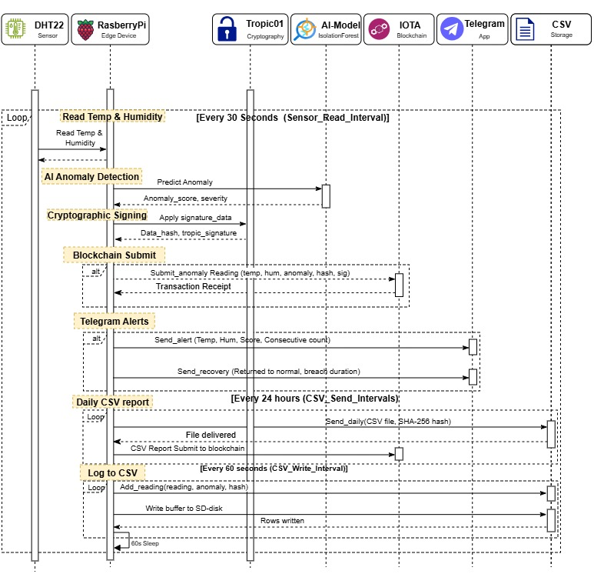
Operational Workflow
1
Read Sensor
DHT22 reads Temp & Humidity every 30 seconds via single-wire protocol
2
AI Anomaly Detection
Isolation Forest computes anomaly score in < 1 ms. Flags if score < 0.
3
Cryptographic Signing
JSON payload → SHA-256 hash → TROPIC01 ECDSA P-256 signing
4
Blockchain Submission
Signed record submitted to IOTA Tangle via JSON-RPC
5
Telegram Alert
Critical anomalies trigger real-time alerts with Temp, Humidity, Score
6
Daily CSV
CSV log SHA-256 hashed and posted to Tangle every 24 hours
Figure 2: Operational Workflow Sequence Diagram
8

Slide 9
Experimental Deployment
142
10,241
5
Operational days
Sensor readings
Anomaly Rate
Oct 2025 – Mar 2026
30-second intervals
512 fagged readings
Environmental Operating Range
Metric | Observed Range | Empirical Safe Zone (mean ± 2σ) | Mean
Temperature | 3.50 – 13.40 °C | 5.5 – 10.5 °C | 8.0 °C
Rel. Humidity | 44.1 – 98.5 %RH | 69.0 – 94.9 %RH | 60% RH
9

Slide 10
Results: Environmental Monitoring
Key Findings
95.0%
readings classified normal (n=9,729)
5.0%
classified anomalous (n=512)
71.3%
of AI anomalies matched rule violations
28.7%
were in-range statistical deviations (n=147)

Slide 11
AI Performance & In-Range Anomalies
Key Discovery
147 anomalies
detected within the safe threshold range, invisible to rule-based methods
Score Distribution
Normal readings cluster at 0.000 – +0.179
Anomalies range from −0.191 to 0.000
Clear score-based separation — no overlap.

Slide 12
Conclusions & Future Work
BlockCold provides a tamper-proof, fully auditable food safety pipeline combining Isolation Forest edge AI, TROPIC01 hardware signing, and IOTA Tangle anchoring. Deployed for 5 months in a real cheese facility, it detects anomalies threshold-based systems miss, generates an EU-compliant forensic record, and runs on commodity hardware at zero blockchain cost.
147
71.3%
~$0
< 1ms
In-range anomalies
unique to AI
AI anomalies
match rule violations
Blockchain
transaction cost
Inference
latency
Future Directions
Multi-Sensor Fusion
Federated Learning
Upstream Extension
Automated Retraining
12

Slide 13

Thank You
Any Questions?
Email: Ullah.azmat@unica.it
13

