Slide 1
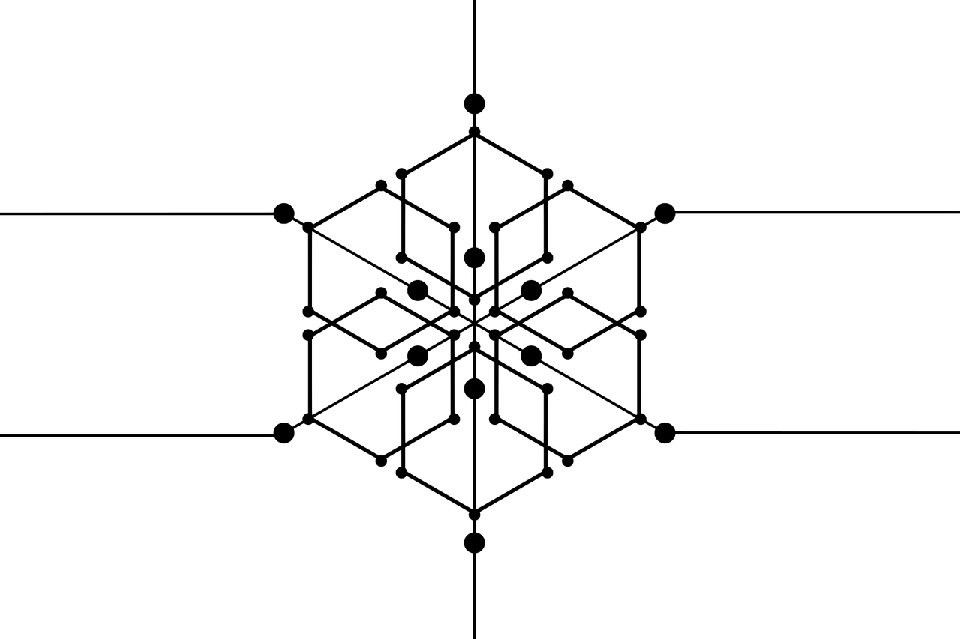


Beyond Transparency: Understanding Consumer Adoption of Blockchain-Traceable Wines
Antonino Galati, Mariantonietta Fiore, Maria Crescimanno, Emanuele Schimmenti, Nino Adamashvili and Angel Peiro-Signes
Dipartimento di Scienze Agrarie, Alimentari e Forestali
Università degli Studi di Palermo …..

Slide 2

Agenda
The main challenges facing the agri-food system
Information asymmetry in agri-food markets
Blockchain technology: what is it?
What factors influence consumers’ intention to purchase wines tracked using blockchain technology?
Conclusions

Slide 3
The main challenges facing the agri-food system
Ensuring food security for a growing population
Making agricultural production sustainable
Reducing food loss and waste
Adapting to climate change and mitigating its effects
Integrating technological innovation equitably
Ensuring social justice and workers’ rights
Promoting healthy and sustainable diets
Stabilizing markets and combating price volatility
Addressing power and information imbalances throughout the supply chain

Slide 4
There is a problem of information asymmetry
i
“A condition that arises in the market when one or more market participants have more precise information than others. In general, it interferes with the proper functioning (➔ economic efficiency; market failures) of markets, leading to situations where available resources are underutilized.”
How can information asymmetry be addressed?

Slide 5


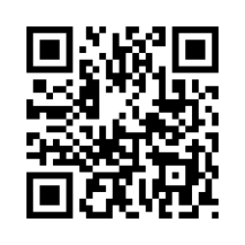
Blockchain Technology: What Is It?
It is a distributed, decentralized digital ledger organized as a sequential chain of encrypted blocks
Each block contains a set of transactions validated by the network nodes through consensus algorithms
i
Once validated, the blocks are sealed and chronologically linked in an inextricable way
Application in the Wine Sector
Integrated with digital interfaces such as QR Codes, the technology transforms "trust attributes" (e.g. authenticity and provenance) into objective data, improving the consumer's ability to evaluate the quality of the wine.

Slide 6

Research gap
What is ALREADY KNOWN
What's MISSING
The existing literature focuses primarily on the perspective of businesses regarding the adoption of emerging technologies.
These studies mainly analyze the benefits, barriers, and technical aspects of implementation in the wine sector.
Particular attention is given to producers’ motivations, organizational factors, and trust in technology.
Limited evidence on how blockchain actually influences consumers’ perceptions and purchase intentions
Little attention paid to the role of pleasure, enjoyment (the QR code user experience), and emotional engagement
A lack of understanding of how psychological factors interact to identify distinct consumer segments

Slide 7
Research Framework and Data Collection
Objective
Analyze the psychological, behavioral, and sociodemographic factors that influence the intention to purchase wines tracked using blockchain technology
Data collection
Questionnaire
Gather information to assess the factors that influence consumer choices
CAWI Quantitative Online Survey, February 2025.

Slide 8





Italy is the world's leading wine producer
19,5% of the World production
44,07 mln hL
36,05 mln hL
31,03 mln hL
33,3 mln hL
23,3 mln hL
22,3 mln hL
Italy is the third-largest wine-consuming country
Second in per capita consumption (42.7 liters)
Source: Our analysis of ISMEA data, 2026

Slide 9
Value of seizures (% of total value)
43.7% of the total value of the Italian agri-food sector
68.6 mln €
301.5 mln €
9.2 mln €
42.6 mln €
22.7 mln €
Source: Our analysis of data from the Central Inspectorate for Quality Control and Fraud Prevention in Agri-Food Products - ICQRF

Slide 10
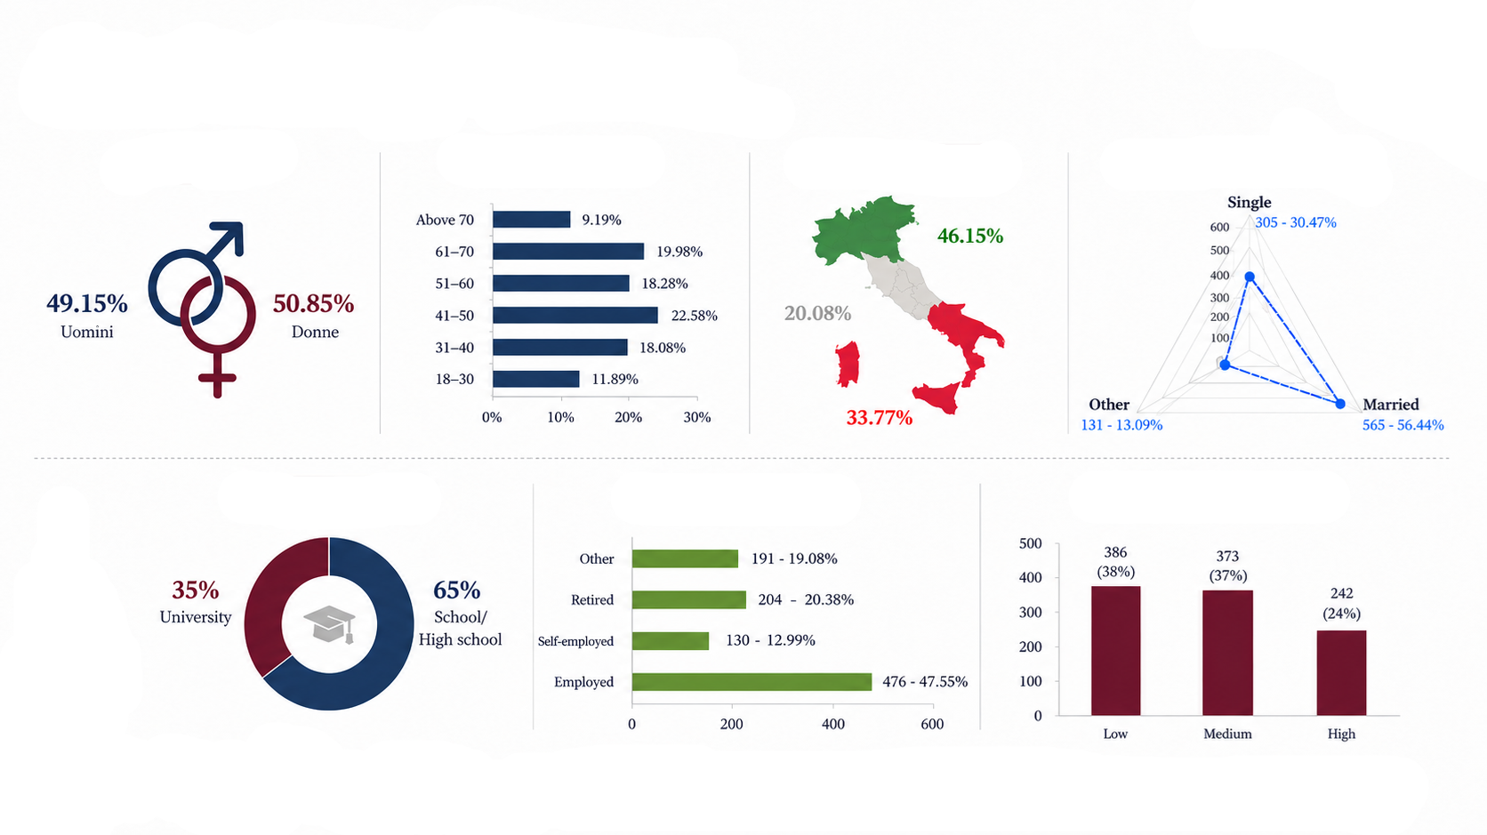



Sample characteristics
Gender
Age
Region
Marital status
Education
Occupation
Revenue
Sample: 1,000 respondents. Residents of Italy, aged 18–80, who have consumed wine in the past 15 days.

Slide 11

Theoretical frameworks and analytical approaches
Framework: SOR + Perceived Risk Theory: technological and social stimuli → consumer psychological states → purchase intention.
Study 1 — Machine Learning
Study 2 — PLS-SEM
Identify the factors that most influence purchase intent
Identify consumer profiles with low, medium, and high propensity
Analyzing the relationships between stimuli, perceptions, and purchase intent
Understanding how purchase intent for traceable wines is formed

Slide 12


Results – Market Segmentation
Which variables are the strongest predictors of the intention to purchase wines tracked via blockchain?
Main drivers
Hedonic perception
Perceived trust
Value perception
Subjective norms
Enabling factors
Blockchain Knowledge
Transparency and perceived traceability
They help translate favorable attitudes into purchase intent, but they do not act as primary drivers.
Marginal variables
Demographic variables
Age, gender, education, and shopping experience

Slide 13
Consumer profiles and intentions
The surrogate model translates XGBoost into simple interpretable rules for segmenting consumers based on their purchase intent.
Necessary condition
Hedonistic perception
High intention
High hedonism
High subjective norms
Reinforcing driver
Subjective standards
Moderately interested
Moderate levels of hedonism and social approval
Open to technology, but not fully convinced
Result
High purchase intent
Reluctant
Low perceived hedonism
Low perceived social approval

Slide 14
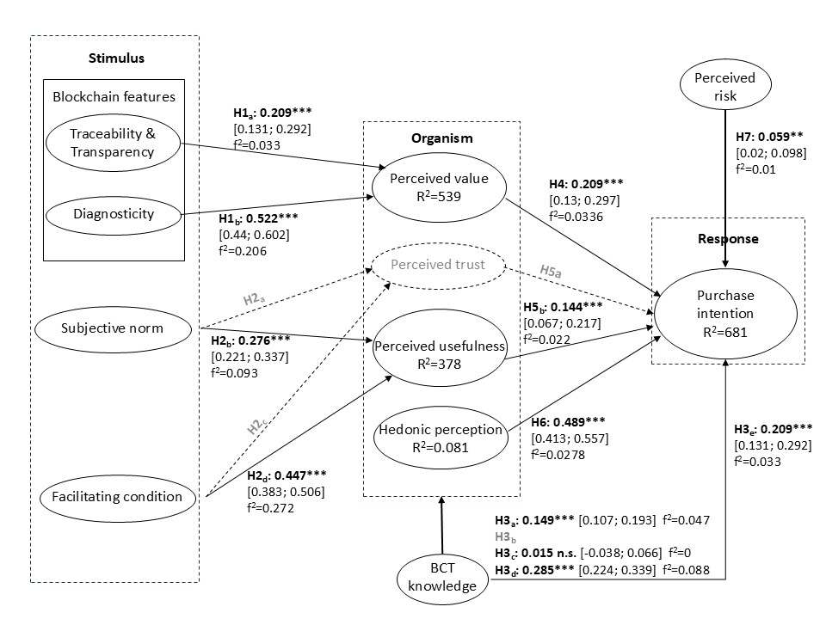
Findings from the PLS-SEM approach
Access to clearer information about origin, quality, and authenticity (diagnosticity) increases the perceived value of wine, leading to a greater willingness to purchase;
At the same time, the presence of favorable conditions (facilitating conditions) enhances the perceived utility of the technology in the eyes of the consumer, making them more likely to adopt the product.

Slide 15

From external factors to perceived value
Emotional engagement drives adoption
Hedonic perception is the strongest driver of purchase intent: traceability must be enjoyable, not just functional.
Perceived value and utility
Consumers prioritize perceived utility and value over concerns about privacy risks or trust in technology.
Social influence
Peer recommendations and expert endorsements increase perceived utility and drive intent.
The user experience
Traceability systems must be intuitive, easy to use, and interactive.

Slide 16
Implications
Communicate traceability as an engaging and enjoyable experience.
Reinforce the perception that consuming traceable wine is socially acceptable and desirable
Focus on communicating the concrete benefits of traceability: assurance of authenticity, verifiable quality, origin, and supply chain transparency
The influence of product diagnosicity suggests that traceability must be designed to enhance the consumer’s ability to better evaluate the product-that is, to make information accessible, easily interpretable, and useful for the purchasing decision

Slide 17
Conclusions
By ensuring the availability of information, its immutability, process transparency, and data security, BCT can help companies stand out from the competition by providing a transparent traceability system and strengthening brand loyalty
By enabling companies to obtain feedback from consumers/customers, BCT can make marketing strategies more effective
It is essential to invest in the digital literacy of human capital and in effective knowledge management systems

Slide 18

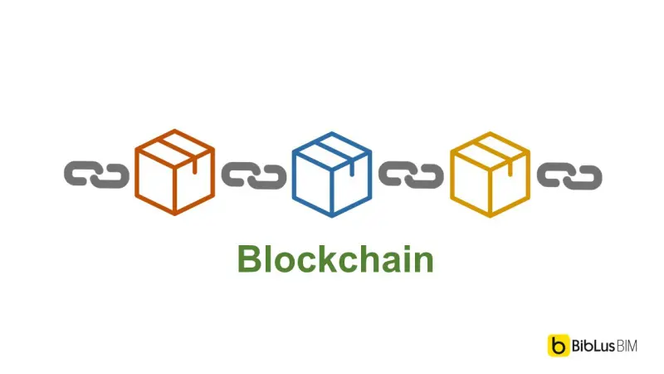
Thank you for your attention

